Slide 1



Data Structures and Algorithms in Python
www.appmillers.com
Elshad Karimov
Elshad Karimov
@karimov_elshad
in/elshad-karimov

Slide 2
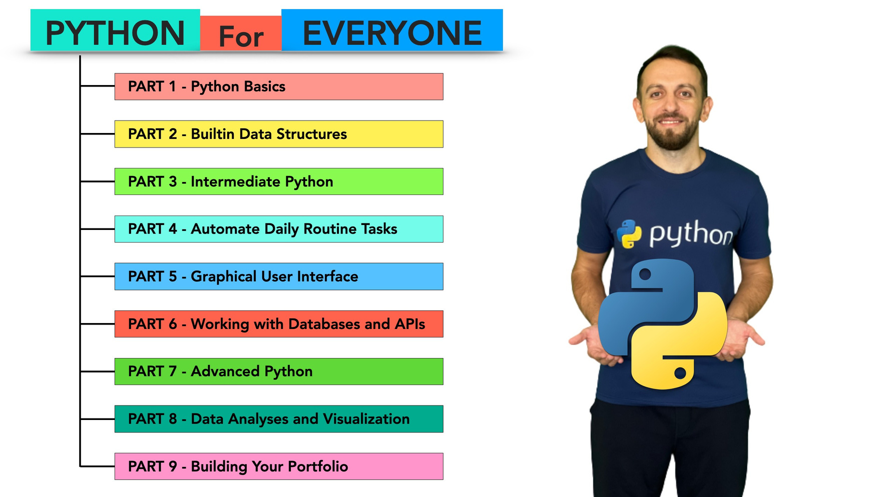
Complete Python Bootcamp for Everyone From Zero to Hero

Slide 3
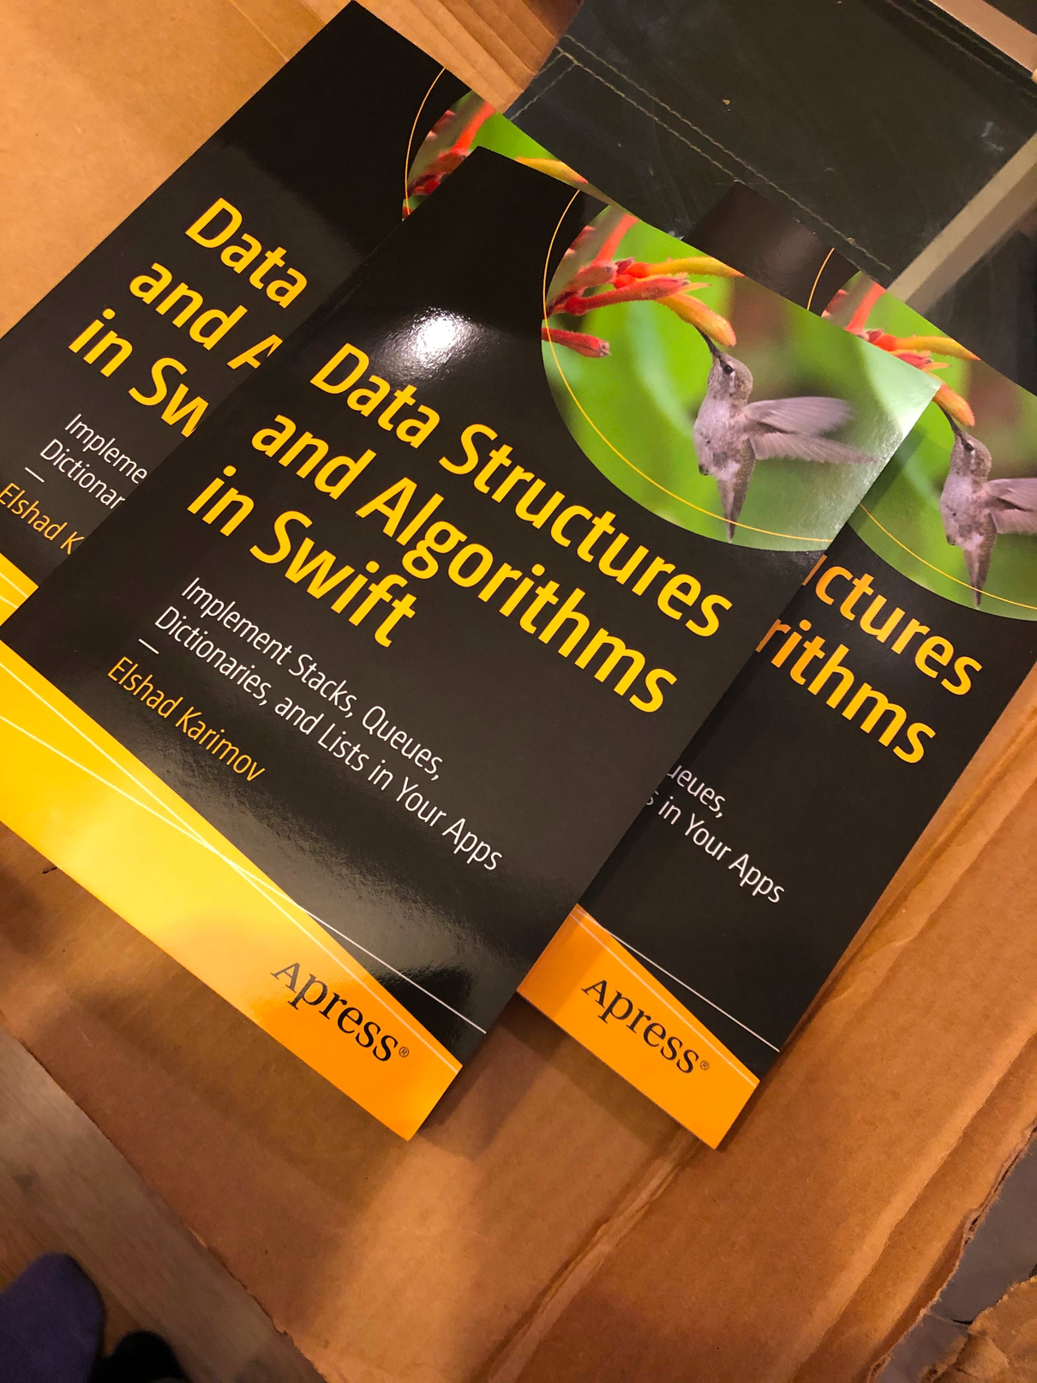
Elshad Karimov
@karimov_elshad
in/elshad-karimov

Slide 4
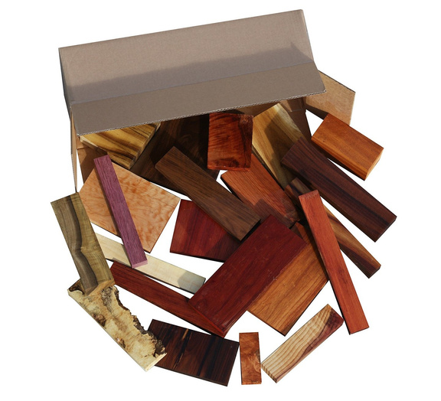
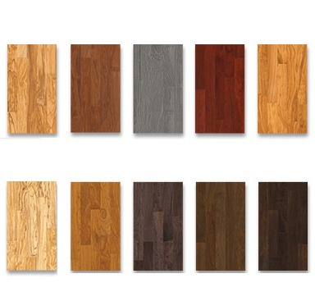

What are Data Structures?
•
Data Structures are diﬀerent ways of organizing data on your computer, that can be used eﬀectively.
AppMillers
www.appmillers.com

Slide 5


What are Data Structures?
•
Data Structures are diﬀerent ways of organizing data on your computer, that can be used eﬀectively.
AppMillers
www.appmillers.com

Slide 6
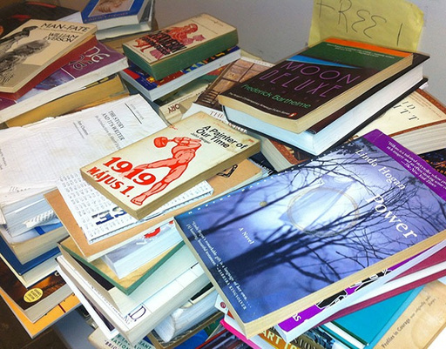

What are Data Structures?
•
Data Structures are diﬀerent ways of organizing data on your computer, that can be used eﬀectively.
AppMillers
www.appmillers.com

Slide 7
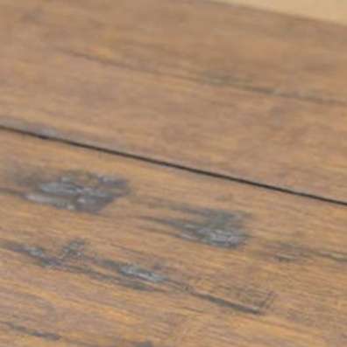
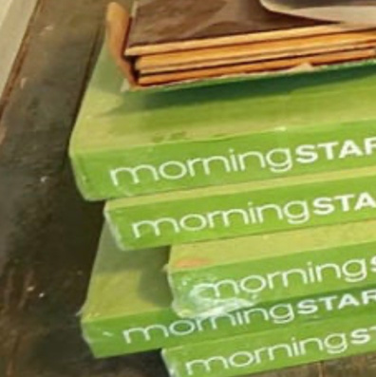
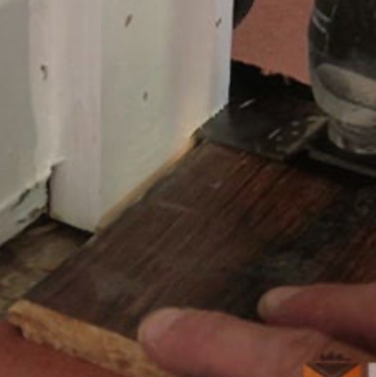
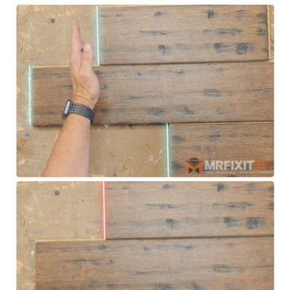

What is an Algorithm?
•
Set of steps to accomplish a task
Step 1: Choosing ﬂooring
Step 2: Purchase and bring
Step 5: Trim door casing
Step 4: Determine the layout
Step 3: Prepare sub ﬂooring
AppMillers
www.appmillers.com

Slide 8


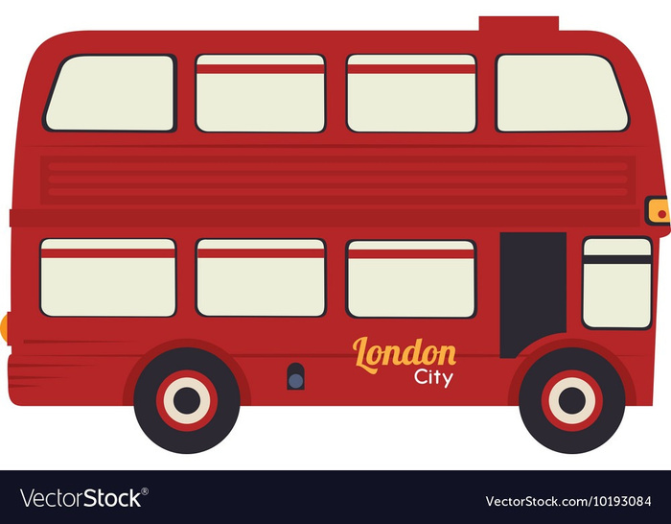
Algorithms in our daily lives
Step 1 : Go to bus stop Step 2 : Take a bus Step 3: Go to oﬃce
AppMillers
www.appmillers.com

Slide 9


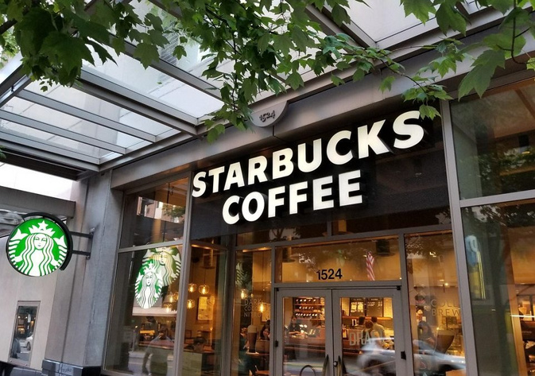
Algorithms in our daily lives
Step 1 : Go to Starbucks Step 2 : Pay money Step 3: Take a coﬀee
AppMillers
www.appmillers.com

Slide 10
Algorithms in Computer Science
•
Set of rules for a computer program to accomplish a task
Input Data
Calculation
Stop when answer found
AppMillers
www.appmillers.com

Slide 11


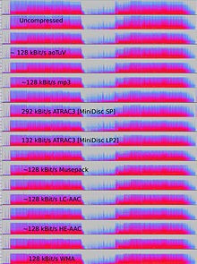
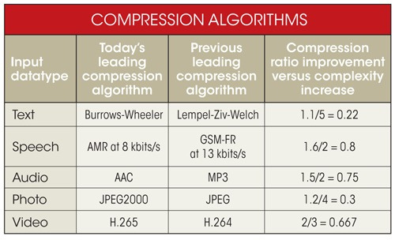
Sample algorithms that are used by big companies
•
How do Google and Facebook transmit live video across the internet?
Compression algorithms
AppMillers
www.appmillers.com

Slide 12
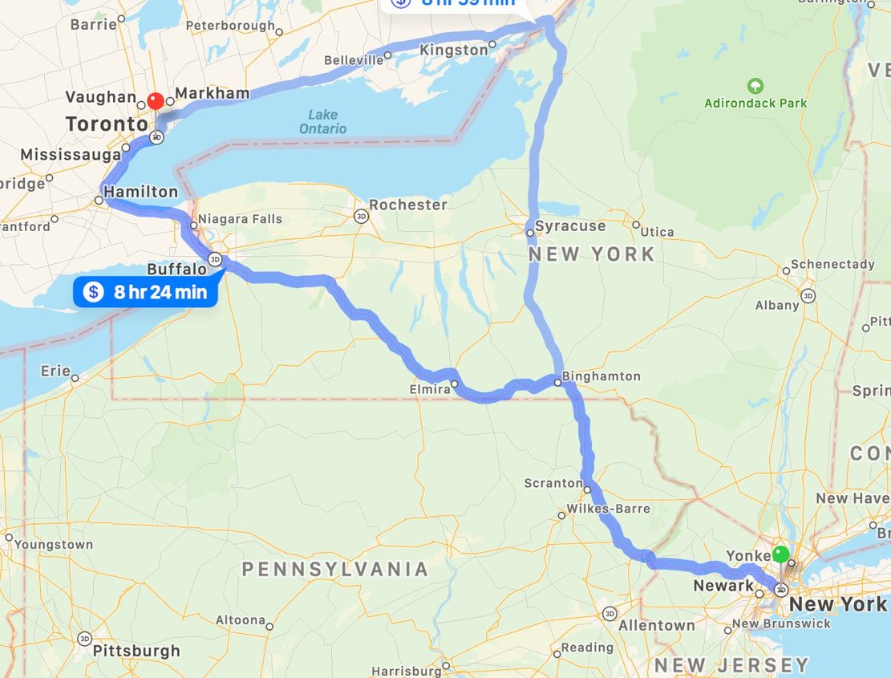
Sample algorithms that are used by big companies
•
How to ﬁnd shortest path on the map?
Compression algorithms
AppMillers
www.appmillers.com

Slide 13
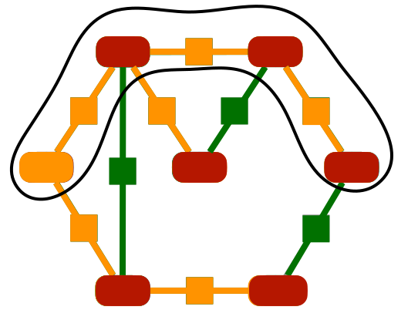
Sample algorithms that are used by big companies
•
How to ﬁnd shortest path on the map?
Dijkstra’s algorithm
min
B vBv ∞2
min
E vEv ∞5
3
2
1
4
9
min
AAv0
DDvv3
GvG1∞4
6
∞
5
7
C vCv ∞5
8
FvF∞13
min
min
AppMillers
www.appmillers.com

Slide 14
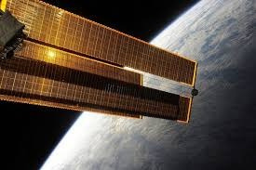
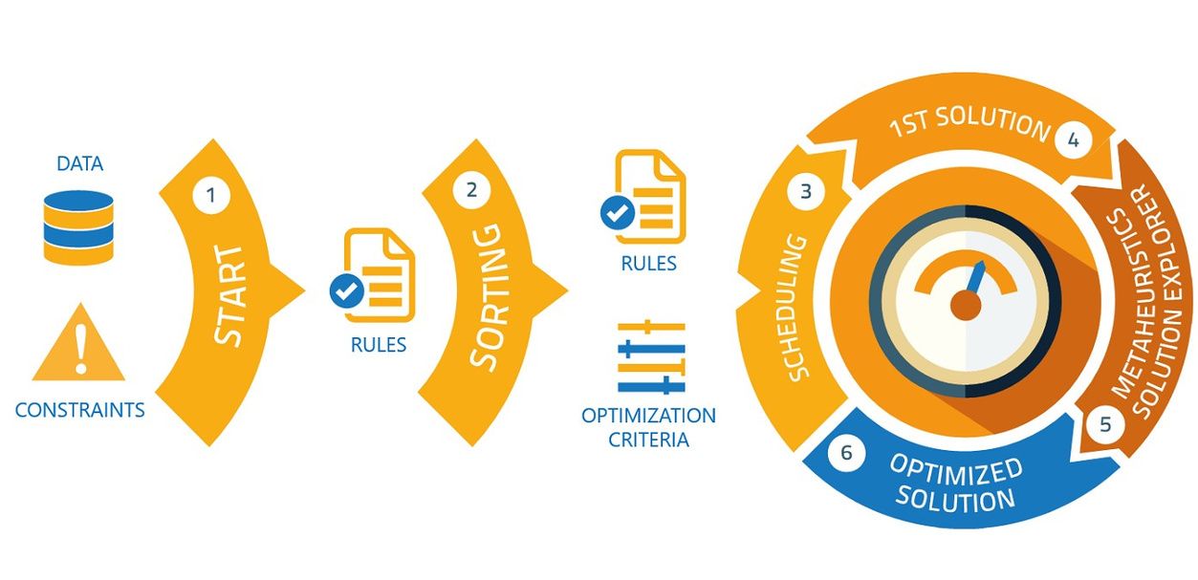
Sample algorithms that are used by big companies
•
How to arrange solar panels on the International Space Station?
Optimization and scheduling algorithms
AppMillers
www.appmillers.com

Slide 15
What makes a good algorithm?
1. Correctness
2. Eﬃciency
AppMillers
www.appmillers.com

Slide 16

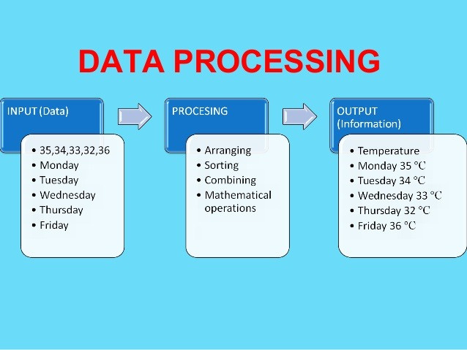
Why are Data Structures and Algorithms important?
AppMillers
www.appmillers.com

Slide 17



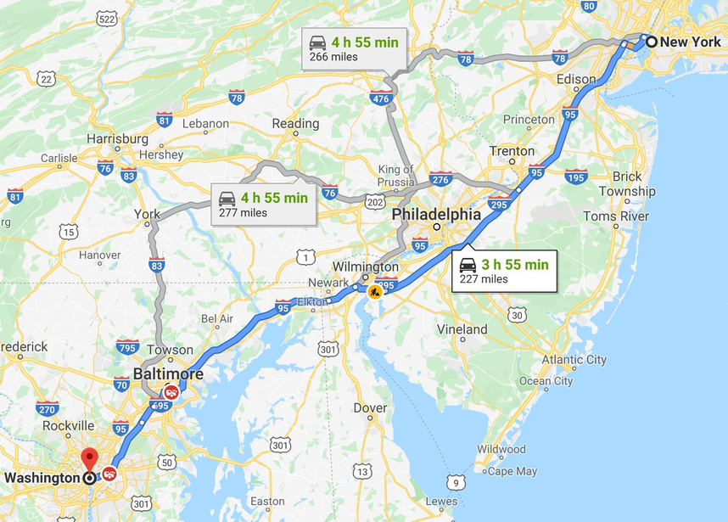

Why are Data Structures and Algorithms important?
Input data
Output
Data Structures and Algorithms
Processing
AppMillers
www.appmillers.com

Slide 18




Why are Data Structures and Algorithms important?
Algorithms
COMPUTER SCIENCE
ALGORITHMS
Algorithms
AppMillers
www.appmillers.com

Slide 19


Why are Data Structures and Algorithms important?
AppMillers
www.appmillers.com

Slide 20



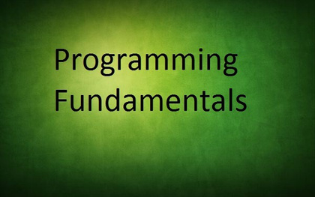
Why are Data Structures and Algorithms in INTERVIEWS?
•
Problem solving skills
•
Fundamental concepts of programming in limited time
AppMillers
www.appmillers.com

Slide 21
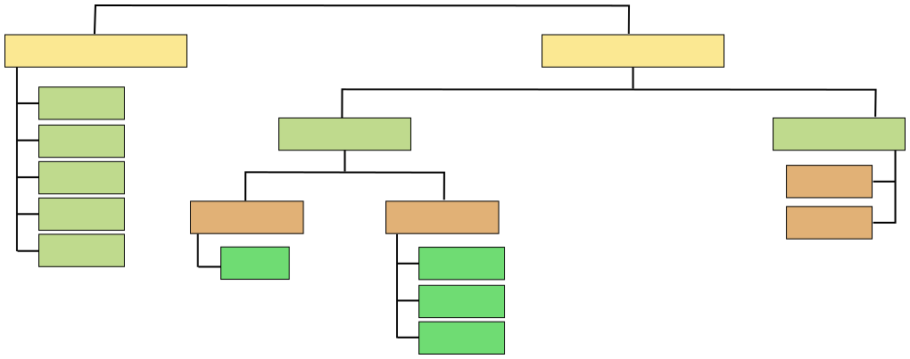
Types of Data Structures
Data Structures
Primitive
Non Primitive
Integer
Float
Linear
Non Linear
Character
Tree
String
Static
Dynamic
Graph
Boolean
Linked List
Array
Stack
Queue
AppMillers
www.appmillers.com

Slide 22
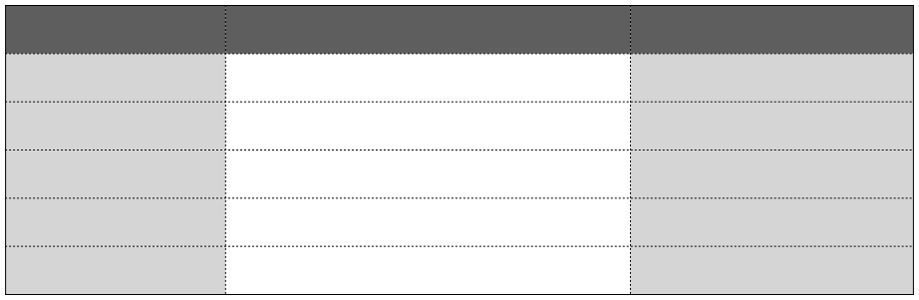
Primitive Data Structures
DATA STRUCTURE INTEGER
Description Numbers without decimal point
Example 1, 2, 3, 4, 5,1000
FLOAT
Numbers with decimal point
3.5, 6.7, 6.987, 20.2
CHARACTER
Single Character
A, B, C, F
STRING
Text
Hello, Data Structure
BOOLEAN
Logical values true or false
TRUE, FALSE
AppMillers
www.appmillers.com

Slide 23
Types of Algorithms
- - - - - -
Simple recursive algorithms Divide and conquer algorithms Dynamic programming algorithms Greedy algorithms Brute force algorithms Randomized algorithms
AppMillers
www.appmillers.com

Slide 24
Types of Algorithms
Simple recursive algorithms
Algorithm Sum(A, n)
if n=1
return A[0]
s = Sum(A, n-1) /* recurse on all but last */
s = s + A[n-1]
/* add last element */
return s
AppMillers
www.appmillers.com

Slide 25
Types of Algorithms
Divide and conquer algorithms
- -
Divide the problem into smaller subproblems of the same type, and solve these subproblems recursively Combine the solutions to the subproblems into a solution to the original problem
Examples: Quick sort and merge sort
AppMillers
www.appmillers.com

Slide 26
Types of Algorithms
Dynamic programming algorithms
- -
They work based on memoization To find the best solution
Greedy algorithms
-We take the best we can without worrying about future consequences. -We hope that by choosing a local optimum solution at each step, we will end up at a global optimum solution
AppMillers
www.appmillers.com

Slide 27
Types of Algorithms
Brute force algorithms
-
It simply tries all possibilities until a satisfactory solution is found
Randomized algorithms
-Use a random number at least once during the computation to make a decision
AppMillers
www.appmillers.com

Slide 28


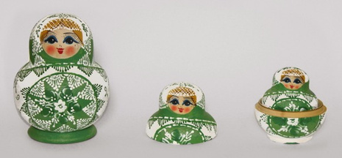

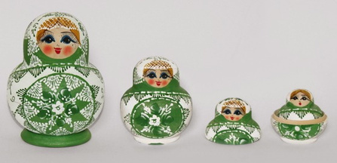
What is Recursion?
Recursion = a way of solving a problem by having a function calling itself
AppMillers
www.appmillers.com

Slide 29

What is Recursion?
Recursion = a way of solving a problem by having a function calling itself
-
Performing the same operation multiple times with different inputs In every step we try smaller inputs to make the problem smaller. Base condition is needed to stop the recursion, otherwise inﬁnite loop will occur.
- -
A programmer's wife tells him as he leaves the house: "While you're out, buy some milk." He never returns home and the universe runs out of milk. 🤣 🤣 🤣
AppMillers
www.appmillers.com

Slide 30
What is Recursion?
Recursion = a way of solving a problem by having a function calling itself
def openRussianDoll(doll):
if doll == 1:
print("All dolls are opened")
else:
openRussianDoll(doll-1)
AppMillers
www.appmillers.com

Slide 31
Why Recursion?
1.Recursive thinking is really important in programming and it helps you break down big
problems into smaller ones and easier to use
-
when to choose recursion?
‣
‣
‣
‣
‣
If you can divine the problem into similar sub problems
Design an algorithm to compute nth…
Write code to list the n…
Implement a method to compute all.
Practice
2.The prominent usage of recursion in data structures like trees and graphs. 3. Interviews 4.It is used in many algorithms (divide and conquer, greedy and dynamic programming)
AppMillers
www.appmillers.com

Slide 32
How Recursion works?
1. 2.
A method calls it self Exit from inﬁnite loop
def recursionMethod(parameters):
if
exit from condition satisfied: return some value
else:
recursionMethod(modified parameters)
AppMillers
www.appmillers.com

Slide 33
How Recursion works?
def firstMethod(): secondMethod() print("I am the first Method")
def secondMethod():
thirdMethod() print("I am the second Method")
def thirdMethod(): fourthMethod() print("I am the third Method")
thirdMethod() secondMethod() ﬁrstMethod()
def fourthMethod():
print("I am the fourth Method")
STACK Memory
AppMillers
www.appmillers.com

Slide 34
How Recursion works?
def recursiveMethod(n):
if n<1:
recursiveMethod(1) recursiveMethod(2) recursiveMethod(3) recursiveMethod(4)
print("n is less than 1")
else:
recursiveMethod(n-1) print(n)
recursiveMethod(4)
4
recursiveMethod(3)
3
STACK Memory
recursiveMethod(2)
2
recursiveMethod(1)
1
recursiveMethod(0)
n is less than 1
AppMillers
www.appmillers.com

Slide 35

Recursive vs Iterative Solutions
def powerOfTwo(n): if n == 0:
def powerOfTwoIt(n):
i = 0 power = 1 while i < n:
return 1
else:
power = powerOfTwo(n-1) return power * 2
power = power * 2 i = i + 1
return power
Points
Recursion
Iteration
Space efficient?
No
Yes
No stack memory require in case of iteration
Time efficient?
No
Yes
In case of recursion system needs more time for pop and push elements to stack memory which makes recursion less time efficient
We use recursion especially in the cases we know
that a problem can be divided into similar sub
problems.
Easy to code?
Yes
No
AppMillers
www.appmillers.com

Slide 36
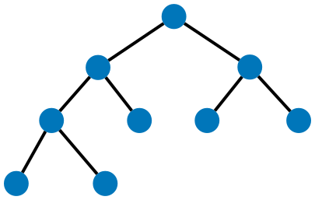
When to Use/Avoid Recursion?
When to use it?
-When we can easily breakdown a problem into similar subproblem
-When we are ﬁne with extra overhead (both time and space) that comes with it
-
-
When we need a quick working solution instead of efficient one
When traverse a tree
15
-When we use memoization in recursion
9
23
-preorder tree traversal : 15, 9, 3, 1, 4, 12, 23, 17, 28
3
12
17
28
When avoid it?
1
4
-If time and space complexity matters for us.
-Recursion uses more memory. If we use embedded memory. For example an application
-
that takes more memory in the phone is not efficient
Recursion can be slow
AppMillers
www.appmillers.com

Slide 37
How to write recursion in 3 steps?
Factorial
- - - -
It is the product of all positive integers less than or equal to n. Denoted by n! (Christian Kramp in 1808). Only positive numbers. 0!=1.
Example 1
4! = 4*3*2*1=24
Example 2
10! = 10*9*8*7*6*5*4*3*2*1=36,28,800
n! = n*(n-1)*(n-2)*…*2*1
AppMillers
www.appmillers.com

Slide 38

How to write recursion in 3 steps?
Step 1 : Recursive case - the ﬂow
n! = n * (n-1) * ( n-2) * … * 2 * 1
n! = n * (n-1)!
(n-1)!
(n-1)! = (n-1) * (n-1-1) * (n-1-2) * … * 2 * 1 = (n-1) * (n-2) * (n-3) * … * 2 * 1
Step 2 : Base case - the stopping criterion
0! = 1 1! = 1
Step 3 : Unintentional case - the constraint
factorial(-1)
?? factorial(1.5) ??
AppMillers
www.appmillers.com

Slide 39
How to write recursion in 3 steps?
def factorial(n):
assert n >= 0 and int(n) == n, 'The number must be positive integer only!' if n in [0,1]:
return 1
else:
return n * factorial(n-1)
factorial(4)= 24
factorial(4)
6
4 * factorial(3)
2
3 * factorial(2)
2 * factorial(1)
1
AppMillers
www.appmillers.com

Slide 40
Fibonacci numbers - Recursion
Fibonacci sequence is a sequence of numbers in which each number is the sum of the two preceding ones and the sequence starts from 0 and 1
0, 1, 1, 2, 3, 5, 8, 13, 21, 34, 55, 89…
Step 1 : Recursive case - the ﬂow
5 = 3 + 2
f(n) = f(n-1) + f(n-2)
Step 2 : Base case - the stopping criterion
0 and 1
Step 3 : Unintentional case - the constraint
ﬁbonacci(-1) ?? ﬁbonacci(1.5) ??
AppMillers
www.appmillers.com

Slide 41
Fibonacci numbers - Recursion
def fibonacci(n):
assert n >=0 and int(n) == n , 'Fibonacci number cannot be negative number or non integer.' if n in [0,1]:
return n
else:
return fibonacci(n-1) + fibonacci(n-2)
0, 1, 1, 2, 3, 5, 8, 13, 21, 34, 55, 89…
ﬁbonacci(4)=3
2
1
ﬁbonacci(3) + ﬁbonacci(2)
1
0
ﬁbonacci(1) + ﬁbonacci(0)
1
1
ﬁbonacci(2) + ﬁbonacci(1)
1
0
ﬁbonacci(1) + ﬁbonacci(0)
AppMillers
www.appmillers.com

Slide 42
Interview Questions - 1
How to ﬁnd the sum of digits of a positive integer number using recursion ?
Step 1 : Recursive case - the ﬂow
10
10/10 = 1 and Remainder = 0
f(n) = n%10 + f(n/10)
54 112
54/10 = 5 and Remainder = 4 112/10 = 11 and Remainder = 2
11/10 = 1 and Remainder = 1
Step 2 : Base case - the stopping criterion
n =0
Step 3 : Unintentional case - the constraint
sumofDigits(-11) ?? sumofDigits(1.5) ??
AppMillers
www.appmillers.com

Slide 43


Interview Question 2 - How to calculate power of a number using recursion?
xn=x*x*x*..(n times)..*x
Step 1 : Recursive case - the ﬂow
24=2*2*2*2 xa * xb=xa+b
x3 * x4=x3+4
xn = x * x
n-1
Step 2 : Base case - the stopping criterion
n = 0
Step 3 : Unintentional case - the constraint
power(-1,2) ?? power(3.2, 2) ?? power(2, 1.2) ?? power(2, -1) ??
www.appmillers.com

Slide 44

Interview Questions - 3
How to ﬁnd GCD ( Greatest Common Divisor) of two numbers using recursion?
Step 1 : Recursive case - the ﬂow
GCD is the largest positive integer that divides the numbers without a remainder
gcd(8,12) = 4 8 = 2 * 2 * 2
12 = 2 * 2 * 3
Euclidean algorithm
gcd(48,18)
Step 1 : 48/18 = 2 remainder 12
Step 2 : 18/12 = 1 remainder 6
Step 3 : 12/6 = 2 remainder 0
gcd(a, 0)=a
gcd(a, b) = gcd(b, a mod b)
Step 2 : Base case - the stopping criterion
b = 0
Step 3 : Unintentional case - the constraint
Positive integers
Convert negative numbers to positive
AppMillers
www.appmillers.com

Slide 45
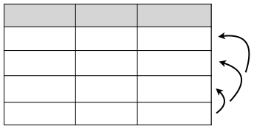
Interview Questions - 4
How to convert a number from Decimal to Binary using recursion
Step 1 : Recursive case - the ﬂow
Step 1 : Divide the number by 2
Step 2 : Get the integer quotient for the next iteration
Step 3 : Get the remainder for the binary digit
Step 3 : Repeat the steps until the quotient is equal to 0
130 to binary
1100110
f(n) = n mod 2 + 10 * f(n/2)
Division by Quotient
Remainder
130/2 65/2
32/2 1/2
65 32
1 0
10 01
10 1
101 * 10 + 0 = 1010
10 * 10 + 1 = 101
1 * 10 + 0 = 10
AppMillers
www.appmillers.com

Slide 46

Dynamic programing & Memoization
900
850
Total : 900 + 850 = 1750
AppMillers
www.appmillers.com

Slide 47
Dynamic programing & Memoization
static int ﬁbonacci(int i) { if (i == 0) return 0; if (i == 1) return 0; return ﬁbonacci(i-1)+ﬁbonacci(i-2); }
ﬁb(5)
ﬁb(4)
ﬁb(3)
ﬁb(2)
ﬁb(3)
ﬁb(2)
ﬁb(1)
ﬁb(2)
ﬁb(1)
ﬁb(1)
ﬁb(0)
ﬁb(1)
ﬁb(0)
ﬁb(1)
ﬁb(0)
AppMillers
www.appmillers.com

Slide 48
Dynamic programing & Memoization
static int ﬁb(int n) { /* Declare an array to store Fibonacci numbers. */ int f[] = new int[n+2]; // 1 extra to handle case, n = 0 int i;
ﬁb(5)
ﬁb(4)
/* 0th and 1st number of the series are 0 and 1*/ f[0] = 0; f[1] = 1; for (i = 2; i <= n; i++) {
ﬁb(3)
ﬁb(2)
ﬁb(3)
/* Add the previous 2 numbers
ﬁb(2)
ﬁb(1)
in the series
and store it */
f[i] = f[i-1] + f[i-2]; }
ﬁb(1)
ﬁb(0)
return f[n]; }
AppMillers
www.appmillers.com

Slide 49




Big O
Big O is the language and metric we use to describe the eﬃciency of algorithms
?
Size : 1TB
AppMillers
www.appmillers.com

Slide 50
Electronic - O(s)
Physical - O(1)
Types
O(N), O(N2), O(2N)
AppMillers
www.appmillers.com

Slide 51

w
h
Time complexity : O(wh)
AppMillers
www.appmillers.com

Slide 52

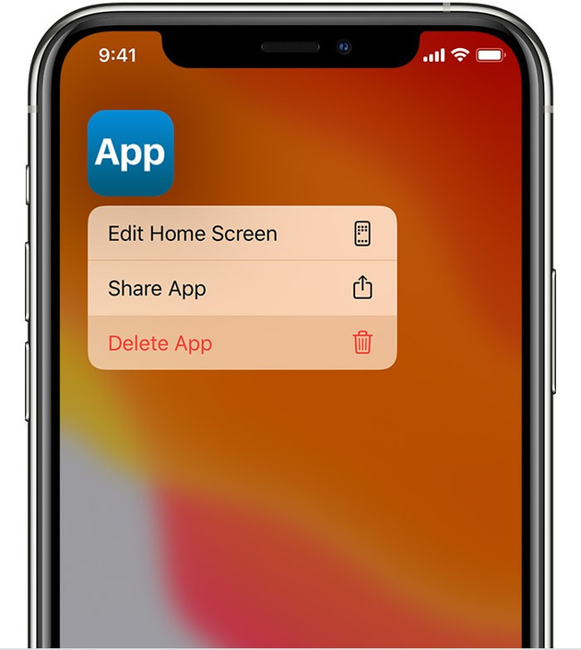
AppMillers
www.appmillers.com

Slide 53

Algorithm run time notations
-City traﬃc - 20 liters -Highway - 10 liters -Mixed condition - 15 liters
AppMillers
www.appmillers.com

Slide 54
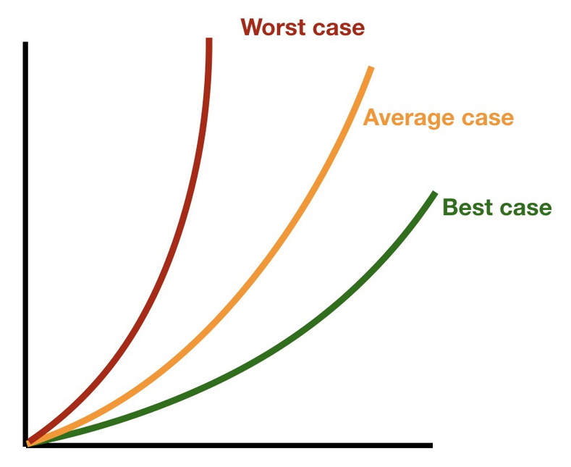
Algorithm run time notations
-Best case -Average case -Worst case
AppMillers
www.appmillers.com

Slide 55
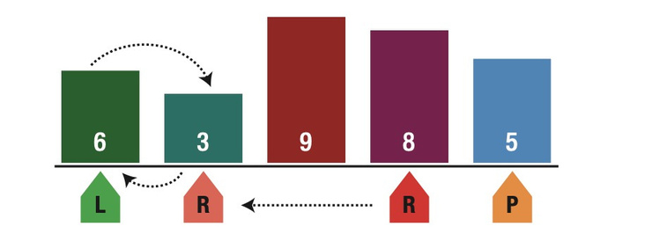
Algorithm run time notations
Quick sort algorithm
O(N2)
O(N log N)
O(N)
AppMillers
www.appmillers.com

Slide 56
Big O, Big Theta and Big Omega
: It is a complexity that is going to be less or equal to the worst case.
• • •
Big O Big - Ω (Big-Omega) case. Big Theta (Big - Θ) cases.
: It is a complexity that is going to be at least more than the best
: It is a complexity that is within bounds of the worst and the best
n
5
4
10
…
8
11
68
87
12
…
90
13
77
55
9
Big O - O(N) Big Ω - Ω(1) Big Θ - Θ(n/2)
AppMillers
www.appmillers.com

Slide 57
Algorithm run time complexities
Complexity O(1) O(N) O(LogN) O(N2) O(2N)
Name Constant Linear Logarithmic Quadratic Exponential
Sample Accessing a speciﬁc element in array Loop through array elements Find an element in sorted array Looking ar a every index in the array twice Double recursion in Fibonacci
O(1) - Constant time
array = [1, 2, 3, 4, 5] array[0] // It takes constant time to access first element
AppMillers
www.appmillers.com

Slide 58
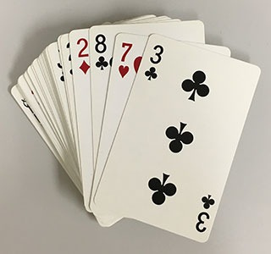
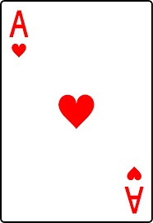
Algorithm run time complexities
Complexity O(1) O(N) O(LogN) O(N2) O(2N)
Name Constant Linear Logarithmic Quadratic Exponential
Sample Accessing a speciﬁc element in array Loop through array elements Find an element in sorted array Looking ar a every index in the array twice Double recursion in Fibonacci
O(1) - Constant time
random card
AppMillers
www.appmillers.com

Slide 59
Algorithm run time complexities
Complexity O(1) O(N) O(LogN) O(N2) O(2N)
Name Constant Linear Logarithmic Quadratic Exponential
Sample Accessing a speciﬁc element in array Loop through array elements Find an element in sorted array Looking ar a every index in the array twice Double recursion in Fibonacci
O(N) - Linear time
array = [1, 2, 3, 4, 5] for element in array:
print(element)
//linear time since it is visiting every element of array
AppMillers
www.appmillers.com

Slide 60

Algorithm run time complexities
Complexity O(1) O(N) O(LogN) O(N2) O(2N)
Name Constant Linear Logarithmic Quadratic Exponential
Sample Accessing a speciﬁc element in array Loop through array elements Find an element in sorted array Looking ar a every index in the array twice Double recursion in Fibonacci
O(N) - Linear time
Speciﬁc card
AppMillers
www.appmillers.com

Slide 61
Algorithm run time complexities
Complexity O(1) O(N) O(LogN) O(N2) O(2N)
Name Constant Linear Logarithmic Quadratic Exponential
Sample Accessing a speciﬁc element in array Loop through array elements Find an element in sorted array Looking ar a every index in the array twice Double recursion in Fibonacci
O(LogN) - Logarithmic time
array = [1, 2, 3, 4, 5] for index in range(0,len(array),3):
print(array[index])
//logarithmic time since it is visiting only some elements
AppMillers
www.appmillers.com

Slide 62
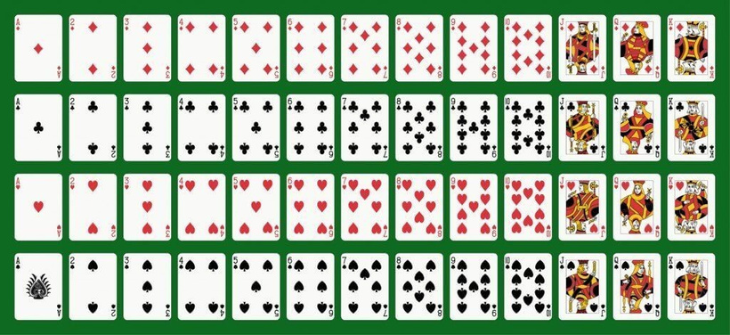
Algorithm run time complexities
Complexity O(1) O(N) O(LogN) O(N2) O(2N)
Name Constant Linear Logarithmic Quadratic Exponential
Sample Accessing a speciﬁc element in array Loop through array elements Find an element in sorted array Looking ar a every index in the array twice Double recursion in Fibonacci
O(LogN) - Logarithmic time
AppMillers
www.appmillers.com

Slide 63
Algorithm run time complexities
Complexity O(1) O(N) O(LogN) O(N2) O(2N)
Name Constant Linear Logarithmic Quadratic Exponential
Sample Accessing a speciﬁc element in array Loop through array elements Find an element in sorted array Looking ar a every index in the array twice Double recursion in Fibonacci
O(LogN) - Logarithmic time
Binary search
search 9 within [1,5,8,9,11,13,15,19,21] compare 9 to 11 → smaller search 9 within [1,5,8,9] compare 9 to 8 → bigger search 9 within [9] compare 9 to 9 return
N = 16
N = 8 N = 4 N = 2 N = 1
/* divide by 2 */ /* divide by 2 */ /* divide by 2 */ /* divide by 2 */
2k = N → log2N = k
AppMillers
www.appmillers.com

Slide 64
Algorithm run time complexities
Complexity O(1) O(N) O(LogN) O(N2) O(2N)
Name Constant Linear Logarithmic Quadratic Exponential
Sample Accessing a speciﬁc element in array Loop through array elements Find an element in sorted array Looking ar a every index in the array twice Double recursion in Fibonacci
O(N2) - Quadratic time
array = [1, 2, 3, 4, 5]
for x in array:
for y in array: print(x,y)
AppMillers
www.appmillers.com

Slide 65
Algorithm run time complexities
Complexity O(1) O(N) O(LogN) O(N2) O(2N)
Name Constant Linear Logarithmic Quadratic Exponential
Sample Accessing a speciﬁc element in array Loop through array elements Find an element in sorted array Looking ar a every index in the array twice Double recursion in Fibonacci
O(N2) - Quadratic time
array = [1, 2, 3, 4, 5]
for x in array:
for y in array: print(x,y)
AppMillers
www.appmillers.com

Slide 66
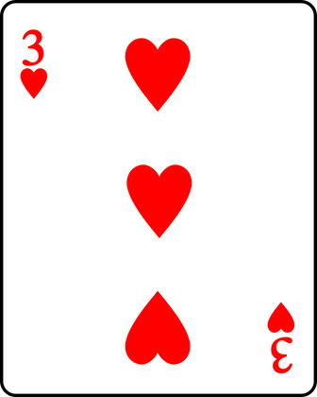
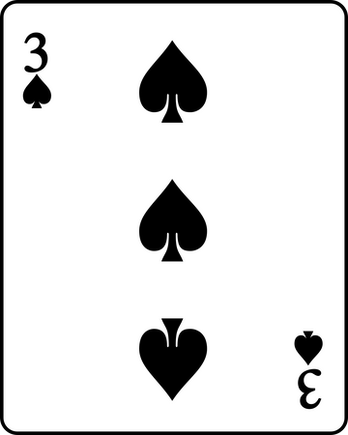
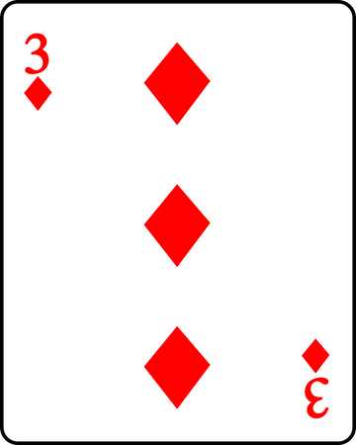
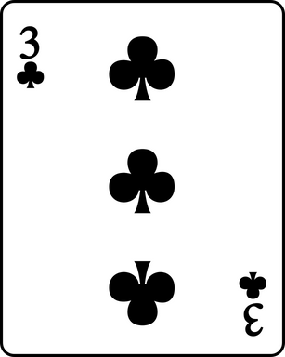
Algorithm run time complexities
Complexity O(1) O(N) O(LogN) O(N2) O(2N)
Name Constant Linear Logarithmic Quadratic Exponential
Sample Accessing a speciﬁc element in array Loop through array elements Find an element in sorted array Looking ar a every index in the array twice Double recursion in Fibonacci
O(N2) - Quadratic time
AppMillers
www.appmillers.com

Slide 67
Algorithm run time complexities
Complexity O(1) O(N) O(LogN) O(N2) O(2N)
Name Constant Linear Logarithmic Quadratic Exponential
Sample Accessing a speciﬁc element in array Loop through array elements Find an element in sorted array Looking ar a every index in the array twice Double recursion in Fibonacci
O(2N) - Exponential time
def fibonacci(n):
if n <= 1:
return n
return fibonacci(n-1) + fibonacci(n-2)
AppMillers
www.appmillers.com

Slide 68
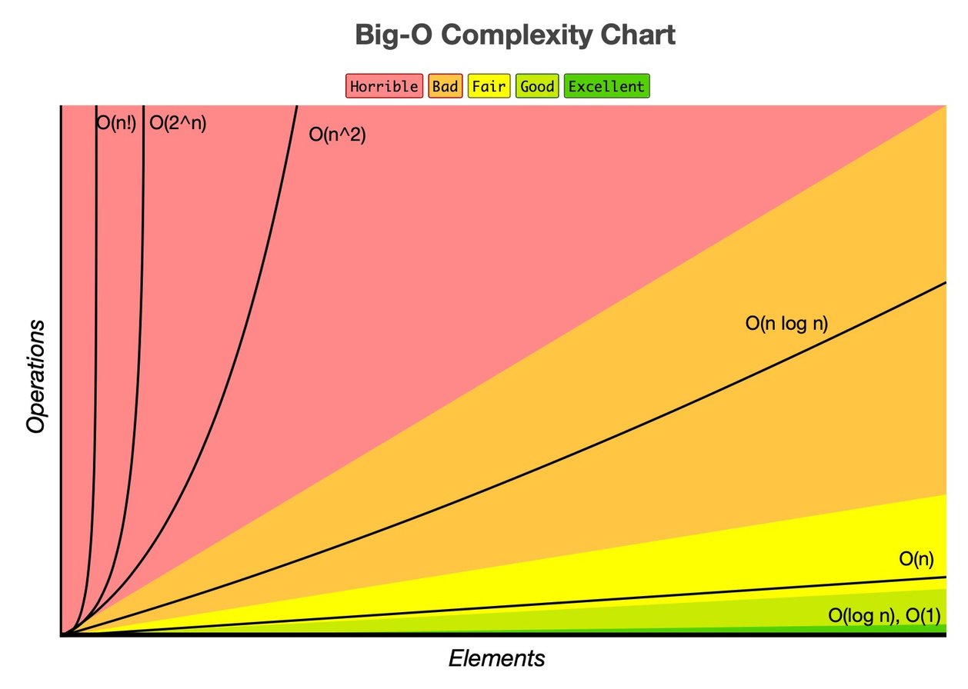
Algorithm run time complexities
AppMillers
www.appmillers.com

Slide 69
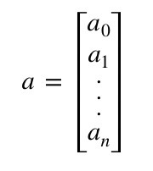
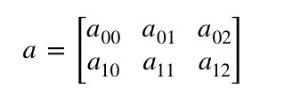
Space complexity
an array of size n
an array of size n*n
O(n)
O(n2)
AppMillers
www.appmillers.com

Slide 70
Space complexity - example
def sum(n): if n <= 0: return 0 else: return n + sum(n-1)
1 sum(3)
2 3 4
→ sum(2)
→ sum(1)
Space complexity : O(n)
→ sum(0)
AppMillers
www.appmillers.com

Slide 71
Space complexity - example
def pairSumSequence(n): sum = 0 for i in range(0,n+1): sum = sum + pairSum(i, i+1) return sum def pairSum(a,b): return a + b
Space complexity : O(1)
AppMillers
www.appmillers.com

Slide 72
Space complexity - example
Java
Python
static int sum(int n) { if (n <= 0) { return 0; } return n + sum(n-1); }
def sum(n): if n <= 0: return 0 else: return n + sum(n-1)
Javascript
Swift
function sum(n) { if (n <= 0) {
func sum(n: Int) -> Int {
}
if n <= 0 {
return 0; } return n + sum(n-1); }
return 0
} return n + sum(n: n-1)
AppMillers
www.appmillers.com

Slide 73
Drop Constants and Non Dominant Terms
Drop Constant
O(2N)
O(N)
Drop Non Dominant Terms
O(N2+N)
O(N2)
O(N+logN)
O(N)
O(2*2N+1000N100)
O(2N)
AppMillers
www.appmillers.com

Slide 74


Why do we drop constants and non dominant terms?
-It is very possible that O(N) code is faster than O(1) code for specific inputs -Different computers with different architectures have different constant factors.
Fast computer Fast memory access
Slow computer Slow memory access
Lower constant
Higher constant
-Different algorithms with the same basic idea and computational complexity might have slightly
different constants
Example: a*(b-c)
vs
a*b - a*c
-As 𝑛→∞, constant factors are not really a big deal
AppMillers
www.appmillers.com

Slide 75
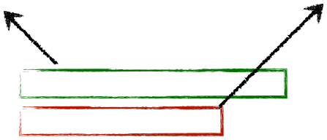
Add vs Multiply
for a in arrayA:
for a in arrayA:
print(a)
for b in arrayB:
print(a, b)
for b in arrayB:
print(b)
Add the Runtimes: O(A + B)
Multiply the Runtimes: O(A * B)
-
If your algorithm is in the form “do this, then when you are all done, do that” then you add the runtimes.
-
If your algorithm is in the form “do this for each time you do that” then you multiply the runtimes.
AppMillers
www.appmillers.com

Slide 76

How to measure the codes using Big O?
No
Description
Any assignment statements and if statements that are executed once regardless of the size of the problem
A simple “for” loop from 0 to n ( with no internal loops)
A nested loop of the same type takes quadratic time complexity
A loop, in which the controlling parameter is divided by two at each step
Complexity
Rule 1
O(1)
Rule 2
Rule 3
O(n)
O(n2)
Rule 4
O(log n)
Rule 5
When dealing with multiple statements, just add them up
sampleArray
5
4
10
…
8
11
68
87
…
def findBiggestNumber(sampleArray):
O(1) O(n)
biggestNumber = sampleArray[0] for index in range(1,len(sampleArray)):
O(n)
}
if sampleArray[index] > biggestNumber: biggestNumber = sampleArray[index]
O(1)
}
O(1)
O(1)
O(1)
print(biggestNumber)
Time complexity : O(1) + O(n) + O(1) = O(n)
AppMillers
www.appmillers.com

Slide 77
How to measure Recursive Algorithm?
sampleArray
5
4
10
…
8
11
68
87
10
def findMaxNumRec(sampleArray, n):
if n == 1:
return sampleArray[0]
return max(sampleArray[n-1],findMaxNumRec(sampleArray, n-1))
Explanation:
A =
11
4
12
7
n = 4
findMaxNumRec(A,4)
max(A[4-1],12)
max(7,12)=12
findMaxNumRec(A,3)
max(A[3-1],11)
max(12,11)=12
findMaxNumRec(A,2)
max(A[2-1],11)
max(4,11)=11
findMaxNumRec(A,1)
A[0]=11
AppMillers
www.appmillers.com

Slide 78
How to measure Recursive Algorithm?
sampleArray
5
4
10
…
8
11
68
87
10
def findMaxNumRec(sampleArray, n):
M(n) O(1) O(1)
M(n-1)
if n == 1:
return sampleArray[0]
return max(sampleArray[n-1],findMaxNumRec(sampleArray, n-1))
M(n)=O(1)+M(n-1)
}
M(n)=1+M(n-1)
M(1)=O(1)
=1+(1+M((n-1)-1)) =2+M(n-2) =2+1+M((n-2)-1) =3+M(n-3)
.
.
=a+M(n-a)
=n-1+M(n-(n-1))
=n-1+1
=n
M(n-1)=O(1)+M((n-1)-1)
M(n-2)=O(1)+M((n-2)-1)
AppMillers
www.appmillers.com

Slide 79
How to measure Recursive Algorithm that make multiple calls?
def findMaxNumRec(sampleArray, n):
if n == 1:
return sampleArray[0]
return max(sampleArray[n-1],findMaxNumRec(sampleArray, n-1))
def f(n):
if n <= 1:
return 1
return f(n-1) + f(n-1)
AppMillers
www.appmillers.com

Slide 80
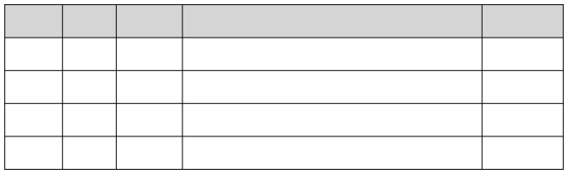
How to measure Recursive Algorithm that make multiple calls?
def f(n):
if n <= 1:
return 1
return f(n-1) + f(n-1)
Level
0
f(4)
f(3)
f(3)
1
f(2)
f(2)
f(2)
f(2)
2
f(1)
f(1)
f(1)
f(1)
f(1)
f(1)
f(1)
f(1)
3
20+21+22+…+2n=2n+1-1
N 4 3 2 1
Level 0 1 2 3
Node#Also can be expressed..
or..
2n-1
O(2n)
1 2 4 8
20 21 22 23
O(branches
depth
)
2 * previous level = 2 2 * previous level = 2 *21=22 2 * previous level = 2 *22=23
AppMillers
www.appmillers.com

Slide 81
Top 10 Big O interview Questions
AppMillers
www.appmillers.com

Slide 82
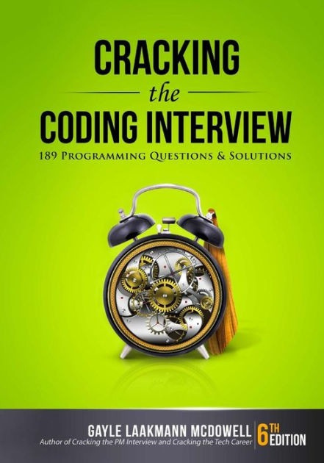


Top 10 Big O interview Questions
in Java 😞
Java to Python
😉
AppMillers
www.appmillers.com

Slide 83
Interview Questions - 1
What is the runtime of the below code?
def foo(array): sum = 0 product = 1 for i in array:
O(1) O(1)
O(n)
O(1)
O(n)
O(1)
O(1)
sum += i
for i in array:
product *= i
print("Sum = "+str(sum)+", Product = "+str(product))
Time Complexity : O(N)
AppMillers
www.appmillers.com

Slide 84
Interview Questions - 2
What is the runtime of the below code?
def printPairs(array):
for i in array:
O(n2)
}
O(n2)
for j in array:
O(n)
print(str(i)+","+str(j))
O(1)
Time Complexity : O(N2)
AppMillers
www.appmillers.com

Slide 85
Interview Questions - 3
What is the runtime of the below code?
def printUnorderedPairs(array):
for i in range(0,len(array)):
for j in range(i+1,len(array)):
print(array[i] + "," + array[j])
1. Counting the iterations
2. Average Work
1st 2nd
n-1 n-2
Outer loop - N times Inner loop?
.
.
1
1st
2nd
10
(n-1)+(n-2)+(n-3)+..+2+1
=1+2+…+(n-3)+(n-2)+(n-1)
=n(n-1)/2
=n2/2 + n
=n2
10/2
= 5
O(N2)
n/2
.1
}9.
n*n/2 = n2/2
Time Complexity : O(N2)
AppMillers
www.appmillers.com

Slide 86
Interview Question - 4
What is the runtime of the below code?
def printUnorderedPairs(arrayA, arrayB):
for i in range(len(arrayA)):
for j in range(len(arrayB)):
if arrayA[i] < arrayB[j]:
print(str(arrayA[i]) + "," + str(arrayB[j]))
def printUnorderedPairs(arrayA, arrayB):
for i in range(len(arrayA)):
for j in range(len(arrayB)):
O(1)
b = len(arrayB) a = len(arrayA)
Time Complexity : O(ab)
AppMillers
www.appmillers.com

Slide 87
Interview Question - 5
What is the runtime of the below code?
def printUnorderedPairs(arrayA, arrayB):
for i in range(len(arrayA)):
O(ab) O?(1)
O(1)
for j in range(len(arrayB)):
}
print(str(arrayA[i]) + "," + str(arrayB[j]))
for k in range(0,100000):
a = len(arrayA) b = len(arrayB)
100,000
units of work is still constant
Time Complexity : O(ab)
AppMillers
www.appmillers.com

Slide 88
Interview Question - 6
What is the runtime of the below code?
def reverse(array):
for i in range(0, int(len(array)/2)):
O(N/2) O(1) O(1)
O(1)
O(1)
O(1)
O(N)
other = len(array)-i-1 temp = array[i] array[i] = array[other] array[other] = temp
print(array)
input
output
1
2
3
4
5
5
4
3
2
1
Time Complexity : O(N)
AppMillers
www.appmillers.com

Slide 89
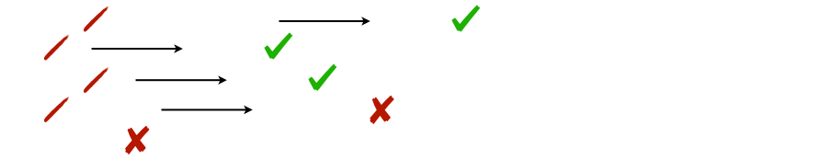
Interview Questions - 7
Which of the following are equivalent to O(N)? Why?
1.O(N + P) , where P < N/2
O(N)
2.O(2N)
3.O(N+logN)
4.O(N + NlogN)
5. O(N+M)
O(N)
O(N)
O(NlogN)
AppMillers
www.appmillers.com

Slide 90
Interview Question - 8
What is the runtime of the below code?
M(n)
def factorial(n): if n < 0:
return -1
O(1)
elif n == 0:
return
}1
else: return n * factorial(n-1)
M(n-1)
n! = 1*2*3*…*n 3! = 1*2*3=6
M(n)=1+M(n-1)
M(n)=O(1)+M(n-1)
=1+(1+M((n-1)-1)) =2+M(n-2) =2+1+M((n-2)-1) =3+M(n-3)
.
.
=a+M(n-a)
=n+M(n-n)
=n+1
=n
M(0)=O(1)
}
M(n-1)=O(1)+M((n-1)-1)
M(n-2)=O(1)+M((n-2)-1)
Time Complexity : O(N)
AppMillers
www.appmillers.com

Slide 91
Interview Question - 9
What is the runtime of the below code?
def allFib(n):
for i in range(n):
print(str(i)+":, " + str(fib(i)))
def fib(n):
if n <= 0:
branches
depth
return 0 elif n == 1: return 1
O(2N)
return fib(n-1) + fib(n-2)
ﬁb(1) ﬁb(2) ﬁb(3) ﬁb(4)
21 steps 22 steps 23 steps 24 steps
Total work = 21+22+23+24+…+2n
= 2n+1-2
…
ﬁb(n)
2n steps
Time Complexity : O(2N)
AppMillers
www.appmillers.com

Slide 92
Interview Question - 10
What is the runtime of the below code?
def powersOf2(n): if n < 1:
return 0
elif n == 1:
O(1)
print(1
return 1
})
else: prev = powersOf2(int(n/2))
curr = prev*2
print(curr)
return curr
O(1)
}
n=50
powersOf(50)
return 32
Time Complexity : O(logN)
powersOf(25)
return 16
powersOf(12)
return 8
powersOf(6)
return 4
powersOf(3)
return 2
x2
powersOf(1)
return 1
AppMillers
www.appmillers.com

Slide 93



Arrays
AppMillers
www.appmillers.com

Slide 94
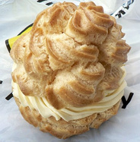
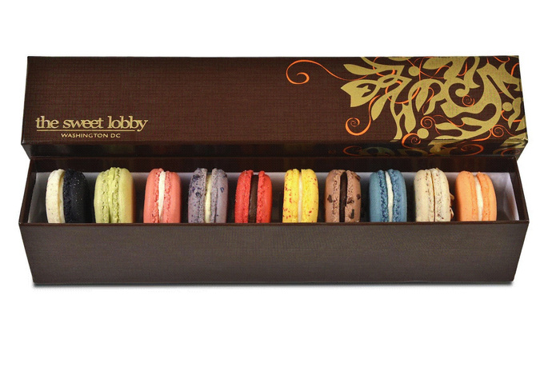
Arrays
- - - -
It is a box of macaroons. All macaroons in this box are next to each other
Each macaroon can be identiﬁed uniquely based on their location The size of box cannot be changed
“a”
4
3
[1]
1
6
8
10
[5]
[0]
[2]
[3]
[4]
- - - -
Array can store data of speciﬁed type Elements of an array are located in a contiguous
Each element of an array has a unique index
The size of an array is predeﬁned and cannot be modiﬁed
AppMillers
www.appmillers.com

Slide 95
What is an Array?
In computer science, an array is a data structure consisting of a collection of elements , each identiﬁed by at least one array index or key. An array is stored such that the position of each element can be computed from its index by a mathematical formula.
4
3
[1]
1
6
8
10
[5]
[0]
[2]
[3]
[4]
Why do we need an Array?
3 variables number1 number2 number3
-What if 500 integer? -Are we going to use 500 variables?
The answer is an ARRAY
AppMillers
www.appmillers.com

Slide 96
Types of Array
Arrays
One Dimensional
Multi dimensional
Two dimensional
Three dimensional
Four dimensional
. .
.
N dimensional
AppMillers
www.appmillers.com

Slide 97



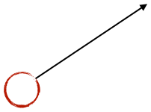

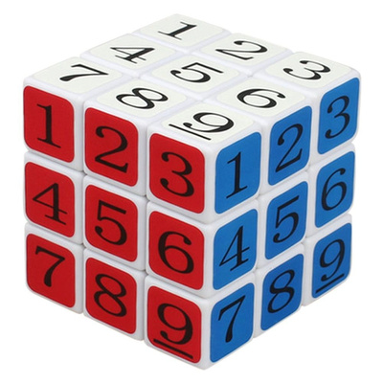

Types of Array
One dimensional array : an array with a bunch of values having been declared with a single index.
a[i] —> i between 0 and n
a[2]
a[5]
5
4
[1]
10
[2]
11
[3]
8
11
68
[6]
87
12
[0]
[4]
[5]
[7]
[8]
Two dimensional array : an array with a bunch of values having been declared with double index.
a[0][4]
[5]
a[i][j] —> i and j between 0 and n
a[2][5]
[0]
[1]
[2]
[3]
[4]
[6]
[7]
[8]
[0] [1] [2]
1 5 24
33 4 50
55 10 37
91 11 40
20 8 48
51 11 30
62 68 59
74 87 81
13 12 93
Three dimensional array : an array with a bunch of values having been declared with triple index. a[i][j][k] —> i , j and k between 0 and n
a[2][0][2] a[0][0][1]
AppMillers
www.appmillers.com

Slide 98
Types of Array
One dimensional array :
5
4
10
11
8
11
68
87
12
Two dimensional array
1 5 24
33 4 50
55 10 37
91 11 40
20 8 48
51 11 30
62 68 59
74 87 81
13 12 93
Three dimensional array
AppMillers
www.appmillers.com

Slide 99

Arrays in Memory
One Dimensional
5
4
10
11
8
11
68
87
12
Memory
5
4
10
11
8
11
68
87
12
AppMillers
www.appmillers.com

Slide 100
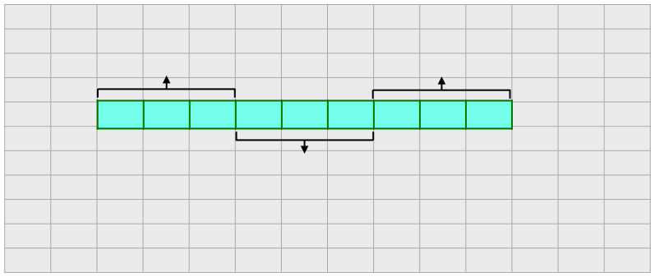
Arrays in Memory
Two Dimensional array
1 4 7
2 5 8
3 6 9
Memory
Row 1
Row 3
1
2
3
4
5
6
7
8
9
Row 2
AppMillers
www.appmillers.com

Slide 101
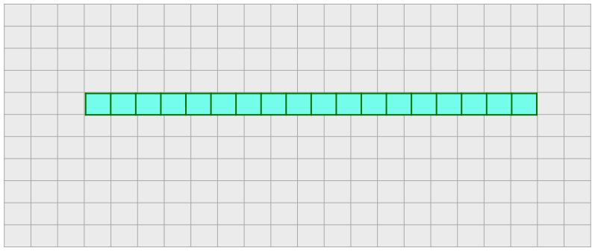
Arrays in Memory
Three Dimensional array
[[[ 0, [ 3, [[ 6,
1, 4, 7,
2], 5]], 8],
[ 9, 10, 11]],
[[12, 13, 14],
[15, 16, 17]]]
Memory
0
1
2
3
4
5
6
7
8
9
10
11
12
13
14
15
16
17
AppMillers
www.appmillers.com

Slide 102

What is an Array?
I’m an
Array
AppMillers
www.appmillers.com

Slide 103
What is an Array?
0
1
2
3
4
5
Not allowed
0
true.
2
“a”
“c”
5
AppMillers
www.appmillers.com

Slide 104
Creating an array
When we create an array , we:
•Assign it to a variable •Define the type of elements that it will store •Define its size (the maximum numbers of elements)
myArray =
myArray =
1
2
3
AppMillers
www.appmillers.com

Slide 105
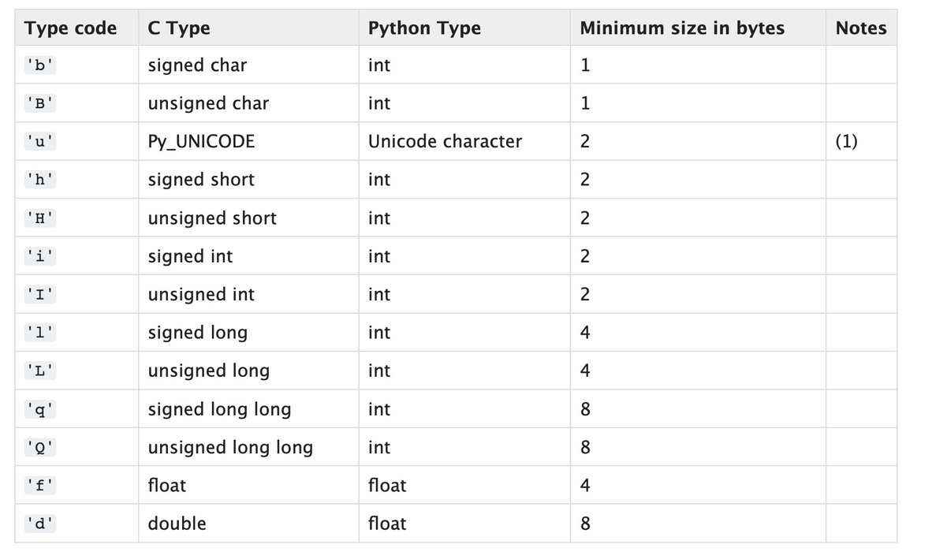
Creating an array (Array Module)
from array import * arrayName = array(typecode, [Initializers])
AppMillers
www.appmillers.com

Slide 106
Insertion
“a” [0]
“b” [1]
“c” [2]
myArray =
[3]
[4]
[5]
myArray[3] = “d” myArray[5] = “f”
AppMillers
www.appmillers.com

Slide 107

Insertion
“f”
“a” [0]
“b” [1]
“c” [2]
“d” [3]
“e” [4]
[5]
AppMillers
www.appmillers.com

Slide 108

Insertion
“f”
“a” [0]
“b” [1]
“c” [2]
“d” [3]
“e” [4]
[5]
“f” [0]
“a” [1]
“b” [2]
“c” [3]
“d” [4]
“e” [5]
AppMillers
www.appmillers.com

Slide 109



⚠
Wait A minute! What Happens if the Array is Full?
“f”
💥
FULL
❗
“a” [0]
“b” [1]
“c” [2]
“d” [3]
“e” [4]
“h”
[5]
AppMillers
www.appmillers.com

Slide 110

Insertion , when an array is full.
“a” [0]
“b” [1]
“c” [2]
“d” [3]
“e” [4]
“h” [5]
“a” “b” “c” “d” “e” “h”
[0]
[1]
[2]
[3]
[4]
[5]
[6]
[7]
[8]
[9]
[10] [11] [12]
AppMillers
www.appmillers.com

Slide 111

Array traversal
“a” [0]
“b” [1]
“c” [2]
“d” [3]
“e” [4]
“f” [5]
myArray =
myArray[0] = “a” myArray[1] = “b” myArray[2] = “c” myArray[3] = “d” myArray[4] = “e” myArray[5] = “f”
AppMillers
www.appmillers.com

Slide 112
Array traversal
def traverseArray(array):
for i in array:
O(n)
}
O(n)
print(i)
O(1)
Time Complexity : O(n)
Space Complexity : O(1)
AppMillers
www.appmillers.com

Slide 113

Access an element of Two Dimensional Array
For example:
myArray =
“a” [0]
“b” [1]
“c” [2]
“d” [3]
“e” [4]
“f” [5]
myArray[0] = “a” myArray[3] = “d”
AppMillers
www.appmillers.com

Slide 114
Access array element
How can we tell the computer which particular value we would like to access?
INDEX
[0]
[1]
[2]
[3]
[4]
[5]
<arrayName>[index]
AppMillers
www.appmillers.com

Slide 115
Access an element of array
def accessElement(array, index):
if index >= len(array):
O(1)
}
print('There is not any element in this index')
O(1)
O(1)
else:
O(1)
print(array[index])
Time Complexity : O(1)
Space Complexity : O(1)
AppMillers
www.appmillers.com

Slide 116


Finding an element
myArray =
“a” [0]
“b” [1]
“c” [2]
“d” [3]
“e” [4]
“h” [5]
myArray[2]
1
2
3
4
5
6
7
8
9
AppMillers
www.appmillers.com

Slide 117

Finding an element
Is this the element?
“a” [0]
“b” [1]
“c” [2]
“d” [3]
“e” [4]
“h” [5]
AppMillers
www.appmillers.com

Slide 118

Finding an element
def searchInArray(array, value):
for i in array:
O(n)
}
if i == value:
O(1)
O(n^2)
return arr.index(value)
O(n)
return "The element does not exist in this array"
O(1)
Time Complexity : O(n)
Space Complexity : O(1)
O(n)
}
O(1)
O(n)
O(1)
O(1)
AppMillers
www.appmillers.com

Slide 119




Deletion
❌
“a” [0]
“b” [1]
“c” [2]
“d” [3]
“e” [4]
“h” [5]
Not allowed
‼
🚫
“a” [0]
“c” [2]
“d” [3]
“e” [4]
“h” [5]
[1]
AppMillers
www.appmillers.com

Slide 120
Deletion
❌
“a” [0]
“b” [1]
“c” [2]
“d” [3]
“e” [4]
“h” [5]
“a” [0]
“c” [1]
“d” [2]
“e” [3]
“h” [4]
[5]
AppMillers
www.appmillers.com

Slide 121

Deletion
❌
“a” [0]
“b” [1]
“c” [2]
“d” [3]
“e” [4]
“h” [5]
Time Complexity : O(n)
Space Complexity : O(1)
AppMillers
www.appmillers.com

Slide 122
Inserting a value to two dimensional array
AppMillers
www.appmillers.com

Slide 123

Array type codes in Python
The 'u' type code corresponds to Python’s obsolete unicode character (Py_UNICODE which is wchar_t). Depending on the platform, it can be 16 bits or 32 bits.
'u'
will be removed together with the rest of the Py_UNICODE API.
Deprecated since version 3.3, will be removed in version 4.0.
AppMillers
www.appmillers.com

Slide 124
Built in functions of arrays in Python
AppMillers
www.appmillers.com

Slide 125

Time and Space Complexity in One Dimensional Arrays
Operation
Time complexity O(1) O(1)/O(n) O(n) O(1) O(n) O(1)/O(n)
Space complexity O(n) O(1) O(1) O(1) O(1) O(1)
Creating an empty array Inserting a value in an array Traversing a given array Accessing a given cell Searching a given value Deleting a given value
AppMillers
www.appmillers.com

Slide 126
Two Dimensional Array
An array with a bunch of values having been declared with double index.
a[i][j] —> i and j between 0 and n
1 5 24
33 4 50
55 10 37
91 11 40
20 8 48
51 11 30
62 68 59
74 87 81
13 12 93
Day 1 - 11, 15, 10, 6 Day 2 - 10, 14, 11, 5 Day 3 - 12, 17, 12, 8 Day 4 - 15, 18, 14, 9
When we create an array , we:
•Assign it to a variable •Define the type of elements that it will store •Define its size (the maximum numbers of elements)
AppMillers
www.appmillers.com

Slide 127


Insertion - Two Dimensional array
1 5 24
10 4 50
11 10 37
15
? ?
Adding Column
3 6 9
1 5 24
10 4 50
11 10 37
3 6 9
1 5 24
10 4 50
11 10 37
Time Complexity = O(mn)
AppMillers
www.appmillers.com

Slide 128


Insertion - Two Dimensional array
1 5 24
10 4 50
11 10 37
15
? ?
Adding Row
3
6
9
1 5 24
10 4 50
11 10 37
3 1 5 24
6 10 4 50
9 11 10 37
Time Complexity = O(mn)
AppMillers
www.appmillers.com

Slide 129

Access an element of Two Dimensional Array
One dimensional array
5
4
[1]
10
[2]
11
[3]
8
11
68
[6]
87
12
[0]
[4]
[5]
[7]
[8]
Two dimensional array
a[i][j] —> i is row index and j is column index
a[0][4]
a[2][5]
[0]
[1]
[2]
[3]
[4]
[5]
[6]
[7]
[8]
[0] [1] [2]
1 5 24
33 4 50
55 10 37
91 11 40
20 8 48
51 11 30
62 68 59
74 87 81
13 12 93
AppMillers
www.appmillers.com

Slide 130

Traversing Two Dimensional Array
1 5 24
33 4 50
55 10 37
91 11 40
133 54
5591 1011 3740
2450
AppMillers
www.appmillers.com

Slide 131

Traversing Two Dimensional Array
Is this the element?
1 5 24
33 4 50
55 44 37
91 11 40
The element is found
AppMillers
www.appmillers.com

Slide 132
Deletion - Two Dimensional array
1 5 24
10 4 50
11 10 37
Deleting Column
❌
1 5 24
1 5 24
10 4 50
11 10 37
10 4 50
11 10 37
Time Complexity = O(mn)
AppMillers
www.appmillers.com

Slide 133
Deletion - Two Dimensional array
1 5 24
10 4 50
11 10 37
Deleting Row
❌
1
10
11
1 5 24
10 4 50
11 10 37
5 24
4 50
10 37
Time Complexity = O(mn)
AppMillers
www.appmillers.com

Slide 134

Time and Space Complexity in 2D Arrays
Operation
Time complexity O(1) O(mn)/O(1) O(mn) O(1) O(mn) O(mn)/O(1)
Space complexity O(mn) O(1) O(1) O(1) O(1) O(1)
Creating an empty array Inserting a column/row in an array Traversing a given array Accessing a given cell Searching a given value Deleting a given value
AppMillers
www.appmillers.com

Slide 135
When to use/avoid Arrays
When to use
- To store multiple variables of same data type - Random access
When to avoid
- Same data type elements - Reserve memory
AppMillers
www.appmillers.com

Slide 136
Summary
•
•
• • • • •
Arrays are extremely powerful data structures Memory is allocated immediately Elements are located in contiguous locations in memory Indices start at 0 Inserting elements Removing elements. Finding elements
AppMillers
www.appmillers.com

Slide 137

Python Lists
A list is a data structure that holds an ordered collection of items.
[Milk, Eggs, Cheese, Butter]
Elements or items
[10, 20, 30, 40]
Integers
['Edy, 'John’, 'Jane’]
Strings
[‘spam’, 1, 2.0, 5]
String, integer, ﬂoat
['spam', 2.0, 5, [10, 20]]
String, integer, ﬂoat, nested list
AppMillers
www.appmillers.com

Slide 138
Arrays vs Lists
Similarities
[10, 20, 30, 40]
Differences
[10, 20, 30, 40]
AppMillers
www.appmillers.com

Slide 139
Time and Space Complexity in Python Lists
Operation
Time complexity O(1) O(1)/O(n) O(n) O(1) O(n) O(1)/O(n)
Space complexity O(n) O(1) O(1) O(1) O(1) O(1)
Creating a List Inserting a value in a List Traversing a given List Accessing a given cell Searching a given value Deleting a given value
AppMillers
www.appmillers.com

Slide 140
Array / List Project
AppMillers
www.appmillers.com

Slide 141
Find Number of Days Above Average Temperature
How many day's temperature?
2
Day 1’s high temp:
1
Day 2’s high temp:
2
Output
Average = 1.5 1 day(s) above average
AppMillers
www.appmillers.com

Slide 142

Array/List Interview Questions - 2
Write a program to find all pairs of integers whose sum is equal to a given number.
[2, 6, 3, 9, 11]
9
[6,3]
AppMillers
www.appmillers.com

Slide 143
Array/List Interview Questions - 2
Write a program to find all pairs of integers whose sum is equal to a given number.
[2, 6, 3, 9, 11]
9
[6,3]
- - - -
-
Does array contain only positive or negative numbers?
What if the same pair repeats twice, should we print it every time?
If the reverse of the pair is acceptable e.g. can we print both (4,1) and (1,4) if the given sum is 5.
Do we need to print only distinct pairs? does (3, 3) is a valid pair forgiven sum of 6?
How big is the array?
AppMillers
www.appmillers.com

Slide 144
Array/List Interview Questions -7
Rotate Matrix
- Given an image represented by an NxN matrix write a method to rotate
the image by 90 degrees.
1 4 7
2 5 8
3 6 9
Rotate 90 degrees
AppMillers
www.appmillers.com

Slide 145

Array/List Interview Questions -7
Rotate Matrix
- Given an image represented by an NxN matrix write a method to rotate
the image by 90 degrees.
1 4 7
2 5 8
3 6 9
7 4 9
2 5 8
1 6 3
7 8 9
4 5 6
1 2 3
for i = 0 to n
temp = top[i] top[i] = left[i] left[i] = bottom[i] bottom[i] = right[i] right[i] = temp
AppMillers
www.appmillers.com

Slide 146
Dictionaries
A dictionary is a collection which is unordered, changeable and indexed.
Miller
: a person who owns or works in a corn mill
Key
Value
myDict = {“Miller” : “a person who owns or works in a corn mill”},
“Programmer" : "a person who writes computer programs"}
0
1
“Programmer”
2
myArray =
“Miller”
“App Miller”
myArray[0]
Miller
myDict[“Miller”]
a person who owns or works in a corn mill
AppMillers
www.appmillers.com

Slide 147

Dictionaries
AppMillers
www.appmillers.com

Slide 148

Dictionaries
0
1
2
AppMillers
www.appmillers.com

Slide 149
Dictionaries
Key
Edy
Tedy
Amy
Value
AppMillers
www.appmillers.com

Slide 150

Dictionary in Memory
A hash table is a way of doing key-value lookups. You store the values in an array, and then use a hash function
to ﬁnd the index of the array cell that corresponds to your key-value pair.
AppMillers
www.appmillers.com

Slide 151
Dictionary in Memory
engToSp = {'one': 'uno', 'two': 'dos', 'three': 'tres'}
one
hash()
1592767615893995073
index = 3
0
1
2
3
one uno
4
AppMillers
www.appmillers.com

Slide 152
Dictionary in Memory
engToSp = {'one': 'uno', 'two': 'dos', 'three': 'tres'}
two
hash()
7028402403723223041
index = 1
0
1
two dos
2
3
one uno
4
AppMillers
www.appmillers.com

Slide 153

Dictionary in Memory
engToSp = {'one': 'uno', 'two': 'dos', 'three': 'tres'}
three
hash()
7028402403723223041
index = 1
0
1
two dos
2
3
one uno
4
three tres
AppMillers
www.appmillers.com

Slide 154

Dictionary in Memory
engToSp = {'one': 'uno', 'two': 'dos', 'three': 'tres'}
ten
hash()
7028402403723223041
index = 1
0
1
two dos
ten
diez
2
3
one uno
4
three tres
AppMillers
www.appmillers.com

Slide 155

Dictionary all method
Cases
All values are true All values are false One value is true (others are false) One value is false (others are true) Empty Iterable
Return Value
TRUE FALSE FALSE FALSE TRUE
AppMillers
www.appmillers.com

Slide 156
Dictionary any method
Cases
All values are true All values are false One value is true (others are false) One value is false (others are true) Empty Iterable
Return Value
TRUE FALSE TRUE TRUE FALSE
•
AppMillers
www.appmillers.com

Slide 157

Dictionary vs List
Dictionary
Unordered
List
Ordered
Access via keys
Access via index
Collection of key value pairs
Collection of elements
Preferred when you have unique key values
Preferred when you have ordered data
No duplicate members
Allow duplicate members
AppMillers
www.appmillers.com

Slide 158

Time and Space Complexity in Python Dictionary
Operation
Time complexity O(len(dict) O(1)/O(n) O(n) O(1) O(n) O(1)
Space complexity O(n) O(1) O(1) O(1) O(1) O(1)
Creating a Dictionary Inserting a value in a Dictionary Traversing a given Dictionary Accessing a given cell Searching a given value Deleting a given value
AppMillers
www.appmillers.com

Slide 159
Tuples
- - - - - - - - -
What is a tuple? How can we create it ? Tuples in Memory Accessing an element of Tuple Traversing / Slicing a Tuple Search for an element in Tuple Tuple Operations/Functions Tuple vs List Tuple vs Dictionary Time and Space complexity of Tuples
AppMillers
www.appmillers.com

Slide 160
What is a Tuple?
A tuple is an immutable sequence of Python objects Tuples are also comparable and hashable
t = 'a', 'b', 'c', 'd', 'e' t = ('a', 'b', 'c', 'd', 'e')
AppMillers
www.appmillers.com

Slide 161

Tuples in Memory
Sample Tuple
‘a’
‘b’
‘c’
‘d’
‘e’
Memory
‘a’
‘b’
‘c’
‘d’
‘e’
AppMillers
www.appmillers.com

Slide 162

Time and Space Complexity in Python Tuples
Operation
Time complexity O(1) O(n) O(1) O(n)
Space complexity O(n) O(1) O(1) O(1)
Creating a Tuple Traversing a given Tuple Accessing a given element Searching a given element
AppMillers
www.appmillers.com

Slide 163


What is a Linked List?
Linked List is a form of a sequential collection and it does not have to be in order. A Linked list is made up of independent nodes that may contain any type of data and each node has a reference to the next node in the link.
Cars (nodes)
Head
Tail
Links
- Each car is independent
- Cars : passengers and links (nodes: data and links)
AppMillers
www.appmillers.com

Slide 164


What is a Linked List?
Cars (nodes)
Head
Tail
Links
Head
001
1
111
2
222
4
333
5
null
Tail
001
111
222
333
Nodes : data and references
AppMillers
www.appmillers.com

Slide 165

What is a Linked List?
Linked List is a form of a sequential collection and It does not have to be in order. A Linked list is made up of independent nodes that may contain any type of data and each node has a reference to the next node in the link.
Head
001
1
111
2
222
4
333
5
null
Tail
001
111
222
333
Nodes
Pointers
AppMillers
www.appmillers.com

Slide 166

Linked Lists vs Arrays
Linked List =
Head
1
1
111
2
222
4
333
5
333
null
001
111
222
Tail
333
Array =
0
1
2
3
4
5
- Elements of Linked list are independent objects - Variable size - the size of a linked list is not predeﬁned - Insertion and removals in Linked List are very efficient.
- Random access - accessing an element is very efficient in arrays
AppMillers
www.appmillers.com

Slide 167

Types of Linked Lists
- - -
Singly Linked List Circular Singly Linked List
SingD
Clyouir cLbuinlylak Liren dD Lkiedus
Lbt ist
-
o
ly Linked List
Head
001
1
111
2
222
4
333
5
null
001
111
222
333
Tail
333
Circular Singly Linked List
Head
001
1
111
2
222
4
333
5
001
001
111
222
333
Tail
333
AppMillers
www.appmillers.com

Slide 168

Circular Singly Linked List
Head
001
Player1
111
Player2
222
Player3
333
Player4
333
001
001
111
222
Tail
333
AppMillers
www.appmillers.com

Slide 169

Types of Linked Lists
Doubly Linked List
Head
001
null
1
111
001
2
111
222
111
4
222
333
222
5
null
001
333
Tail
333
AppMillers
www.appmillers.com

Slide 170

Types of Linked Lists
Head
001
null
S1
001
111
001
S2
222
111
S3
333
222
S4
null
111
222
333
Tail
333
AppMillers
www.appmillers.com

Slide 171

Types of Linked Lists
Circular Doubly Linked List
Head
001
333
1
111
001
2
222
111
4
333
222
5
001
001
111
222
333
Tail
333
AppMillers
www.appmillers.com

Slide 172

Types of Linked Lists
Cmd+shift+tab
Head
001
333
APP1
111
001
APP2
222
111
APP3
333
222
APP4
001
001
111
222
333
Tail
333
AppMillers
www.appmillers.com

Slide 173

Linked List in Memory
Arrays in memory :
0
1
2
3
4
5
Memory
0
1
2
3
4
5
AppMillers
www.appmillers.com

Slide 174

Linked List in Memory
Linked list:
Head
1
1
111
2
222
4
333
5
null
2
Memory
4
Tail
5
1
Head
AppMillers
www.appmillers.com

Slide 175
Creation of Singly Linked List
Head
111
Node
Create Head and Tail, initialize with null
1
null
111
Tail
111
Create a blank Node and assign a value to it and reference to null.
Link Head and Tail with these Node
AppMillers
www.appmillers.com

Slide 176
Creation of Singly Linked List
Create Head and Tail, initialize with null
O(1)
Create a blank Node and assign a value to it and reference to null.
O(1)
Link Head and Tail with these Node
O(1)
AppMillers
www.appmillers.com

Slide 177
Insertion to Linked List in Memory
1. At the beginning of the linked list. 2. After a node in the middle of linked list 3. At the end of the linked list.
AppMillers
www.appmillers.com

Slide 178

Insertion to Linked List in Memory
Insert a new node at the beginning
0
Head
1
1
111
2
222
4
333
5
null
2
0
Memory
4
5
1
❌
Head
AppMillers
www.appmillers.com

Slide 179

Insertion to Linked List in Memory
3
Insert a new node after a node
5
Head
1
1
111
2
222
4
333
null
0
❌
2
Memory
Head
4
5
1
3
AppMillers
www.appmillers.com

Slide 180


Insertion to Linked List in Memory
3
Insert a new node at the end of linked list
1
5
Head
1
111
2
222
4
333
null
3
0
2
Memory
Head
4
5
1
AppMillers
www.appmillers.com

Slide 181

Insertion Algorithm
Node value
- -
create node
head=None?
No
Location
assign value
Yes
- -
head = node tail = node
node.next = head head = node
Yes
- -
Location = ﬁrst
No
- - -
node.next = null last.next = node tail = node
Yes
Terminate
Location = last
Find location (loop) current.next = node node.next =nextNode
No
- - -
AppMillers
www.appmillers.com

Slide 182

Singly Linked List Insertion at the beginning
Head
404041
1
111
2
222
4
333
5
null
Tail
001
111
222
333
- -
node.next = head head = node
6
444
AppMillers
www.appmillers.com

Slide 183

Singly Linked List Insertion at the end
Head
001
1
111
2
222
4
333
5
n4 u4 l 4l
Tail
001
111
222
333
- - -
node.next = null last.next = node tail = node
6
null
444
AppMillers
www.appmillers.com

Slide 184

Singly Linked List Insertion in the middle
Head
001
1
111
2
222
4
343443
5
null
Tail
001
111
222
333
- - -
ﬁnd location (loop) current.next = node node.next =nextNode
6
333
444
AppMillers
www.appmillers.com

Slide 185
Singly Linked list Traversal
Head
001
1
111
2
222
4
333
5
null
Start
Check Head?
Yes
- -
Loop all nodes Print value
No
Terminate
AppMillers
www.appmillers.com

Slide 186

Singly Linked list Search
Head
001
1
111
2
222
4
333
5
null
No
Start
Check Head?
Yes
If
nodeValue
nodeValue=currentNode
No
Yes
Terminate
AppMillers
www.appmillers.com

Slide 187

Singly Linked list Deletion
-Deleting the ﬁrst node -Deleting any given node -Deleting the last node
Case 1 - one node
Head
0n 0u 1l l
1
null
001
Tail
n0 u0 l 1l
AppMillers
www.appmillers.com

Slide 188

Singly Linked list Deletion
-Deleting the ﬁrst node -Deleting any given node -Deleting the last node
Case 2 - more than one node
Head
10 10 1
1
111
2
222
4
333
5
null
001
111
222
333
Tail
333
AppMillers
www.appmillers.com

Slide 189

Singly Linked list Deletion
-Deleting the ﬁrst node -Deleting any given node -Deleting the last node
Head
001
1
111
2
23 23 32
4
333
5
null
001
111
222
333
Tail
333
AppMillers
www.appmillers.com

Slide 190
Singly Linked list Deletion
-Deleting the ﬁrst node -Deleting any given node -Deleting the last node
Case 1 - one node
Head
0n 0u 1l l
1
null
001
Tail
n0 u0 l 1l
AppMillers
www.appmillers.com

Slide 191

Singly Linked list Deletion
-Deleting the ﬁrst node -Deleting any given node -Deleting the last node
Case 2 - more than one node
Head
001
1
111
2
222
4
3n 3u 3l l
5
null
001
111
222
333
Tail
32 32 23
AppMillers
www.appmillers.com

Slide 192

Singly Linked list Deletion Algorithm
Location
head=None?
No
Yes
- -
head = null tail = null
Yes
Location = ﬁrst
-
head = ﬁrst.next
No
- -
-
- -
head = null tail = null
Yes
Terminate
Find node before last node (loop) beforeLast.next = null tail = beforeLast
Location = last
No
- -
ﬁnd location (loop) current.next = nextNode.next
AppMillers
www.appmillers.com

Slide 193

Delete entire Singly Linked list
Head
0n 0u 1l l
1
111
2
222
4
333
5
333
null
001
111
222
Tail
3n 3u 3l l
AppMillers
www.appmillers.com

Slide 194

Time and Space complexity of Singly Linked List
Time complexity O(1) O(n) O(n) O(n) O(n) O(1)
Space complexity O(1) O(1) O(1) O(1) O(1) O(1)
Creation Insertion Searching Traversing Deletion of a node Deletion of linked list
Head
001
1
111
2
222
4
333
5
333
null
001
111
222
Tail
333
AppMillers
www.appmillers.com

Slide 195

Circular Singly Linked List
Singly Linked List
Head
001
1
111
2
222
4
333
5
333
null
001
111
222
Tail
333
Circular Singly Linked List
Head
001
1
111
2
222
4
333
5
333
001
001
111
222
Tail
333
AppMillers
www.appmillers.com

Slide 196

Creation of Circular Singly Linked List
Head
001
1
001
Tail
001
001
Start
nodeValue
- -
Create Blank Node node.value=nodeValue
-
node.next=node
Terminate
- -
head=node tail=node
AppMillers
www.appmillers.com

Slide 197

Circular Singly Linked List - Insertion
-Insert at the beginning of linked list -Insert at the speciﬁed location of linked list -Insert at the end of linked list
node1
node2
node3
node4
Head
40 40 41
1
111
2
222
3
333
4
333
40 40 41
001
111
222
Tail
333
AppMillers
www.appmillers.com

Slide 198

Circular Singly Linked List - Insertion
-Insert at the beginning of linked list
newNode
6
001
444
node1
node2
node3
node4
Head
40 40 41
1
111
2
222
3
333
4
333
404041
001
111
222
Tail
333
AppMillers
www.appmillers.com

Slide 199

Circular Singly Linked List - Insertion
-Insert at the speciﬁed location of linked list
newNode
6
222
444
node1
node2
node3
node4
Head
001
1
111
2
24 42 42
3
333
4
333
001
001
111
222
Tail
333
AppMillers
www.appmillers.com

Slide 200

Circular Singly Linked List - Insertion
-Insert at the end of linked list
newNode
7
001
555
node1
node2
node3
node4
Head
001
1
111
2
222
3
333
4
333
05 05 15
001
111
222
Tail
35 53 53
AppMillers
www.appmillers.com

Slide 201

Insertion Algorithm - Circular singly linked list
nodeValue
Check
Yes
- -
create newNode assign value
location
Linked?
No
- - -
newNode.next = head head = newNode tail.next = newNode
Yes
location = ﬁrst ?
No
Terminate
- - -
newNode.next = tail.next tail.next = newNode tail = newNode
Yes
location = last ?
ﬁnd location (loop) newNode.next = currentNode.next currentNode.next = newNode
No
- - -
AppMillers
www.appmillers.com

Slide 202

Circular Singly Linked List - Traversal
node1
node2
node3
node4
Head
001
1
111
2
222
3
333
4
333
001
001
111
222
Tail
333
print(node1.value) print(nodeS2ta.vrtalue) print(node3.value) print(node4.value)
1 2 3 4
Check Head?
Yes
print(currentNode.value)
No
Terminate
AppMillers
www.appmillers.com

Slide 203

Circular Singly Linked List - Searching
node1
node2
node3
node4
Head
001
1
111
2
222
3
333
4
333
001
001
111
222
Tail
333
No
nodeValue
Check Head?
Yes
If currentNode=node
No
Yes
Terminate
AppMillers
www.appmillers.com

Slide 204

Circular Singly Linked list - Deletion
-Deleting the ﬁrst node -Deleting any given node -Deleting the last node
Case 1 - one node
Head
0n 0u 1l l
1
n0 0u 1l l
001
Tail
n0 u0 l 1l
AppMillers
www.appmillers.com

Slide 205

Circular Singly Linked list - Deletion
-Deleting the ﬁrst node -Deleting any given node -Deleting the last node
Case 2 - more than one node
Head
10 10 1
1
111
2
222
4
333
5
01 01 1
001
111
222
333
Tail
333
AppMillers
www.appmillers.com

Slide 206

Circular Singly Linked list - Deletion
-Deleting the ﬁrst node -Deleting any given node -Deleting the last node
node1
node2
node3
node4
Head
001
1
111
2
23 23 32
4
333
5
001
001
111
222
333
Tail
333
AppMillers
www.appmillers.com

Slide 207
Circular Singly Linked list - Deletion
-Deleting the ﬁrst node -Deleting any given node -Deleting the last node
Case 1 - one node
Head
0n 0u 1l l
1
n0 0u 1l l
001
Tail
n0 u0 l 1l
AppMillers
www.appmillers.com

Slide 208

Circular Singly Linked list - Deletion
-Deleting the ﬁrst node -Deleting any given node -Deleting the last node
Case 2 - more than one node
node1
node2
node3
node4
Head
001
1
111
2
222
4
30 30 13
5
001
001
111
222
333
Tail
32 32 23
AppMillers
www.appmillers.com

Slide 209
Circular Singly Linked list Deletion Algorithm
Location
head=None?
No
Yes
- - -
-
-
head = none tail = none ﬁrst.next = none
Yes
head = ﬁrst.next tail.next = head
Location = ﬁrst
- - -
-
- -
head = none tail = none ﬁrst.next = none
No
Find node before last node
(loop)
Tail = curNode
curNode.next = head
Yes
Terminate
Location = last
No
- -
ﬁnd location (loop) current.next = nextNode.next
AppMillers
www.appmillers.com

Slide 210

Circular Singly Linked list - Deletion Algorithm
node1
node2
node3
node4
node5
Head
001
1
111
2
222
4
333
5
444
6
444
001
001
111
222
333
Tail
444
deleteNode(head, location):
if head does not exist:
return error //Linked list does not exist
if location = ﬁrstNode’s location
if this is the only node in the list
head=tail=node.next=null
else
head=head.next tail.next = head
else if location = lastNode's location if this is the only node in the list
head=tail=node.next=null
else
loop until lastNode location -1 (curNode)
tail=curNode curNode.next = head
else // delete middle node
loop until location-1 (curNode)
curNode.next = curNode.next.next
AppMillers
www.appmillers.com

Slide 211
Circular Singly Linked list - Deletion Algorithm
node1
node2
node3
node4
node5
Head
001
1
111
2
222
4
333
5
444
6
444
001
001
111
222
333
Tail
444
deleteNode(head, location):
if head does not exist:
return error //Linked list does not exist
if location = ﬁrstNode’s location
if this is the only node in the list
head=tail=node.next=null
else
head=head.next tail.next = head
else if location = lastNode's location if this is the only node in the list
head=tail=node.next=null
else
loop until lastNode location -1 (curNode)
tail=curNode curNode.next = head
else // delete middle node
loop until location-1 (curNode)
curNode.next = curNode.next.next
AppMillers
www.appmillers.com

Slide 212

Delete entire Circular Singly Linked list
Head
0n 0u 1l l
1
111
2
222
4
333
5
333
n0 0u 1l l
001
111
222
Tail
3n 3u 3l l
AppMillers
www.appmillers.com

Slide 213

Delete entire Circular Singly Linked List
node1
node2
node3
node4
node5
Head
001
1
111
2
222
4
333
5
444
6
444
001
001
111
222
333
Tail
444
deleteLinkedList(head, tail):
head = null tail.next = null Tail = null
AppMillers
www.appmillers.com

Slide 214

Time and Space complexity of Circular Singly Linked List
Time complexity O(1) O(n) O(n) O(n) O(n) O(1)
Space complexity O(1) O(1) O(1) O(1) O(1) O(1)
Creation Insertion Searching Traversing Deletion of a node Deletion of linked list
node1
node2
node3
node4
node5
Head
001
1
111
2
222
4
333
5
444
6
444
001
001
111
222
333
Tail
444
AppMillers
www.appmillers.com

Slide 215

Doubly Linked List
Singly Linked List
Head
001
1
111
2
222
3
333
4
333
null
001
111
222
Tail
333
Doubly Linked List
Head
001
null
1
111
001
2
111
222
111
3
222
333
222
4
null
001
333
Tail
333
AppMillers
www.appmillers.com

Slide 216

Creation of Doubly Linked List
Head
111
null
5
null
Tail
111
111
Start
nodeValue
- -
Create Blank Node node.value=nodeValue
- -
node.next=Null node.prev=Null
Terminate
- -
head=node tail=node
AppMillers
www.appmillers.com

Slide 217
Doubly Linked List
Head
111
Tail
createDoublyLinkedList(nodeValue):
create a blank node node.value = nodeValue head = node tail = node node.next = node.prev = null
Time complexity : O(1)
Space complexity : O(1)
AppMillers
www.appmillers.com

Slide 218
Doubly Linked List - Insertion
-Insert at the beginning of linked list -Insert at the speciﬁed location of linked list -Insert at the end of linked list
Head
001
null
1
111
001
2
111
222
111
4
222
333
222
5
null
001
333
Tail
333
AppMillers
www.appmillers.com

Slide 219

Doubly Linked List - Insertion
-Insert at the beginning of linked list
newNode
null
10
002
001
node1
node2
node3
node4
Head
0021
0n 0u 2l l
1
111
001
2
111
222
111
4
222
333
222
5
null
001
333
Tail
333
AppMillers
www.appmillers.com

Slide 220

Doubly Linked List - Insertion
-Insert at the speciﬁed location of linked list
newNode
111
20
555
222
node1
node2
node3
node4
Head
001
null
1
111
001
2
111
25 25 52
15 15 15
4
222
333
222
5
null
001
333
Tail
333
AppMillers
www.appmillers.com

Slide 221

Doubly Linked List - Insertion
-Insert at the end of linked list
newNode
333
20
444
null
node1
node2
node3
node4
Head
001
null
1
111
001
2
111
222
111
4
222
333
222
5
n4u44ll
001
333
Tail
34 34 43
AppMillers
www.appmillers.com

Slide 222
Insertion Algorithm - Doubly linked list
nodeValue
check Head?
Yes
- -
create newNode assign value
location
No
- - - -
newNode.prev = None newNode.next = head head.prev = newNode head = newNode
Yes
location = ﬁrst ?
No
- - - -
newNode.next = None newNode.prev = tail tail.next = newNode tail = newNode
Yes
Terminate
location = last ?
- - - - -
ﬁnd location-1 (loop) newNode.next = currentNode.next newNode.prev = currentNode newNode.next.prev = newNode currentNode.next = newNode
No
AppMillers
www.appmillers.com

Slide 223
Insertion in Doubly Linked List
newNode
node1
node2
node3
node4
Head
001
null
1
111
001
2
111
222
111
4
222
333
222
5
null
001
333
Tail
333
AppMillers
www.appmillers.com

Slide 224

Insertion Algorithm - Doubly Linked List
newNode
003
Head
001
null
1
001
111
001
2
111
222
111
4
222
333
222
5
null
333
Tail
333
insertInDoublyLinkedList(head, nodeValue, location):
if head does not exist:
return error //Linked list does not exist
else
create blank node (newNode) newNode.value = nodeValue
Time complexity : O(1)
if location = ﬁrstNode’s location
Space complexity : O(1)
newNode.prev = null newNode.next = head head.prev = newNode head = newNode
else if location = lastNode's location
newNode.next = null newNode.prev = tail tail.next = node tail = node
else // delete middle node
loop until location-1 (curNode)
AppMillers
www.appmillers.com
newNode.next = curNode.next newNode.prev = curNode curNode.next = newNode

Slide 225

Doubly Linked List - Traversal
Head
001
null
1
111
001
2
111
222
111
3
222
333
222
4
null
001
333
Tail
333
print(node1.value) print(nodeS2ta.vrtalue) print(node3.value) print(node4.value)
1 2 3 4
Check Head?
Yes
Loop head to tail
print(currentNode.value)
No
Terminate
AppMillers
www.appmillers.com

Slide 226

Doubly Linked List - Reverse Traversal
Head
001
null
1
111
001
2
111
222
111
3
222
333
222
4
null
001
333
Tail
333
print(node4.value) print(nodeS3ta.vrtalue) print(node2.value) print(node1.value)
4 3 2 1
Check Head?
Yes
Loop tail to head
print(currentNode.value)
No
Terminate
AppMillers
www.appmillers.com

Slide 227

Doubly Linked List - Search
Head
001
null
1
111
001
2
111
222
111
3
222
333
222
4
null
001
333
Tail
333
No
Start
Check Head?
Yes
If
nodeValue
nodeValue=currentNode
No
Yes
Terminate
AppMillers
www.appmillers.com

Slide 228

Traversal in doubly linked list
Head
001
null
1
111
001
2
111
222
111
4
222
333
222
5
null
001
333
Tail
333
traversalDoublyLinkedList():
if head == null:
return //There is not any node in this list
loop head to tail:
print(currentNode.value)
Time complexity : O(n) Space complexity : O(1)
AppMillers
www.appmillers.com

Slide 229
Reverse Traversal in doubly linked list
node1
node2
node3
node4
Head
001
null
1
111
001
2
111
222
111
4
222
333
222
5
null
001
333
Tail
333
reverseTraversalDoublyLinkedList(head):
if head == null:
return //There is not any node in this list
loop tail to head:
print(currentNode.value)
Time complexity : O(1)
Space complexity : O(1)
AppMillers
www.appmillers.com

Slide 230
Searching a node in doubly linked list
node1
node2
node3
node4
Head
001
null
1
111
001
2
111
222
111
4
222
333
222
5
null
001
333
Tail
333
searchForNode(head, nodeValue):
loop head to tail:
if currentNode.value = nodeValue
print(currentNode) return
return // nodeValue not found
Time complexity : O(n) Space complexity : O(1)
AppMillers
www.appmillers.com

Slide 231

Doubly Linked list - Deletion
-Deleting the ﬁrst node -Deleting any given node -Deleting the last node
Case 1 - one node
node1
Head
n0 0u 1l l
null
1
null
001
Tail
0n 0u 1l l
AppMillers
www.appmillers.com

Slide 232

Doubly Linked list - Deletion
-Deleting the ﬁrst node -Deleting any given node -Deleting the last node
Case 2 - more than one node
node1
1
node2
2
node3
4
node4
Head
10101
null
111
0n 0u 1l l
222
111
333
222
5
null
001
111
222
333
Tail
333
AppMillers
www.appmillers.com

Slide 233

Doubly Linked list - Deletion
-Deleting the ﬁrst node -Deleting any given node -Deleting the last node
node1
1
node2
2
node3
4
node4
Head
001
null
111
001
111
333
121212
5
null
222
001
111
222
333
Tail
333
AppMillers
www.appmillers.com

Slide 234

Doubly Linked list - Deletion
-Deleting the ﬁrst node -Deleting any given node -Deleting the last node
Case 1 - one node
node1
Head
0n 0u 1l l
null
1
null
001
Tail
0n 0u 1l l
AppMillers
www.appmillers.com

Slide 235

Doubly Linked list - Deletion
-Deleting the ﬁrst node -Deleting any given node -Deleting the last node
Case 2 - more than one node
node1
1
node2
2
node3
4
node4
Head
001
null
111
001
222
111
333
222
5
null
null
001
111
222
333
Tail
323223
AppMillers
www.appmillers.com

Slide 236

Doubly Linked list Deletion Algorithm
Location
head=None?
No
Yes
- -
head = none tail = none
-
-
Yes
head = head.next head.prev = null
Location = ﬁrst
No
- -
head = none tail = none
Yes
Terminate
Location = last
- -
tail = tail.prev tail.next = null
ﬁnd location-1 (loop) curNode.next = curNode.next.next curNode.next.prev = curNode
No
- - -
AppMillers
www.appmillers.com

Slide 237
Deleting a node in doubly linked list- Algorithm
node1
node2
node3
node4
Head
001
null
1
111
001
2
111
222
111
4
222
333
222
5
null
001
333
Tail
333
deleteNode(head, location):
if head does not exist:
return error //Linked list does not exist
if location = ﬁrstNode’s location
if this is the only node in the list
Time complexity : O(n)
head=tail=null
Space complexity : O(1)
else
head=head.next head.prev = null
else if location = lastNode's location if this is the only node in the list
head=tail=null
else
loop until lastNode location -1 (curNode)
tail=curNode curNode.next = head
else // delete middle node
loop until location-1 (curNode)
curNode.next = curNode.next.next curNode.next.prev = curNode
AppMillers
www.appmillers.com

Slide 238

Deleting entire doubly linked list- Algorithm
node1
node2
node3
node4
Head
0n 0u 1l l
null
1
111
n0 u0 l 1l
2
111
222
n1u11ll
4
222
333
n2 2u 2l l
5
null
001
333
Tail
3n 3u l 3l
AppMillers
www.appmillers.com

Slide 239
Time and Space complexity of doubly linked list
Time complexity O(1) O(n) O(n) O(n) O(n) O(n)
Space complexity O(1) O(1) O(1) O(1) O(1) O(1)
Creation Insertion Searching Traversing (forward, backward) Deletion of a node Deletion of linked list
Head
001
null
1
001
111
001
2
111
222
111
4
222
333
222
5
null
333
Tail
333
AppMillers
www.appmillers.com

Slide 240


Circular doubly linked list
Doubly linked list
Head
001
null
1
111
001
2
111
222
111
4
222
333
222
5
null
001
333
Tail
333
Circular Doubly linked list
Head
001
333
1
001
111
001
2
111
222
111
4
222
333
222
5
333
001
Tail
333
AppMillers
www.appmillers.com

Slide 241

Creation of Circular Doubly Linked List
Head
001
001
11
001
Tail
001
001
Start
nodeValue
- -
Create Blank Node node.value=nodeValue
- -
head=node tail=node
Terminate
- -
node.next=node node.prev=node
AppMillers
www.appmillers.com

Slide 242

Circular Doubly Linked List - Insertion
-Insert at the beginning of linked list -Insert at the speciﬁed location of linked list -Insert at the end of linked list
Head
001
333
1
111
001
2
111
222
111
4
222
333
222
5
001
001
333
Tail
333
AppMillers
www.appmillers.com

Slide 243

Circular Doubly Linked List - Insertion
-Insert at the beginning of linked list
newNode
333
6
444
001
node1
node2
node3
node4
Head
40 40 41
43 43 43
1
111
001
2
111
222
111
4
222
333
222
5
040441
001
333
Tail
333
AppMillers
www.appmillers.com

Slide 244

Circular Doubly Linked List - Insertion
-Insert at the speciﬁed location of linked list
newNode
111
20
555
222
node1
node2
node3
node4
Head
001
null
1
111
001
2
111
25 25 52
15 15 15
4
222
333
222
5
null
001
333
Tail
333
AppMillers
www.appmillers.com

Slide 245

Circular Doubly Linked List - Insertion
-Insert at the end of linked list
newNode
333
20
444
001
node1
node2
node3
node4
Head
001
43 43 43
1
111
001
2
111
222
111
4
222
333
222
5
04 04 41
001
333
Tail
34 34 43
AppMillers
www.appmillers.com

Slide 246

Insertion Algorithm - Circular Doubly linked list
nodeValue
check Head?
Yes
- -
create newNode assign value
location
No
- - - - -
newNode.prev = tail newNode.next = head head.prev = newNode head = newNode tail.next = newNode
Yes
location = ﬁrst ?
No
- - - - -
newNode.next = head newNode.prev = tail head.prev = newNode tail.next = newNode tail = newNode
Terminate
Yes
location = last ?
- - - - -
ﬁnd location-1 (loop) newNode.next = currentNode.next newNode.prev = currentNode newNode.next.prev = newNode currentNode.next = newNode
No
AppMillers
www.appmillers.com

Slide 247

Circular Doubly Linked List - Traversal
Head
001
333
1
111
001
2
111
222
111
3
222
333
222
4
001
001
333
Tail
333
No
print(node1.value) print(nodeS2ta.vrtalue) print(node3.value) print(node4.value)
1 2 3 4
Check Head?
Yes
Loop head to tail print(currentNode.value) If currentNode=
tail
No
Yes
Terminate
AppMillers
www.appmillers.com

Slide 248

Circular Doubly Linked List - Reverse Traversal
Head
001
333
1
111
001
2
111
222
111
3
222
333
222
4
001
001
333
Tail
333
No
print(node4.value) print(nodeS3ta.vrtalue) print(node2.value) print(node1.value)
4 3 2 1
Check Head?
Yes
Loop tail to head print(currentNode.value If currentNode =
head
No
Yes
Terminate
AppMillers
www.appmillers.com

Slide 249

Circular Doubly Linked List - Search
Head
001
333
1
111
001
2
111
222
111
3
222
333
222
4
001
001
333
Tail
333
No
Start
Check Head?
Yes
If nodeValue=currentNode
nodeValue
or if currentNode = tail
No
Yes
Terminate
AppMillers
www.appmillers.com

Slide 250

Circular Doubly Linked list - Deletion
-Deleting the ﬁrst node -Deleting any given node -Deleting the last node
Case 1 - one node
node1
Head
n0 0u 1l l
0n 0u l 1l
1
0n 0u 1l l
001
Tail
0n 0u 1l l
AppMillers
www.appmillers.com

Slide 251

Circular Doubly Linked list - Deletion
-Deleting the ﬁrst node -Deleting any given node -Deleting the last node
Case 2 - more than one node
node1
1
node2
2
node3
4
node4
5
Head
10101
333
111
03 03 13
222
111
333
222
01011
001
111
222
333
Tail
333
AppMillers
www.appmillers.com

Slide 252

Circular Doubly Linked list - Deletion
-Deleting the ﬁrst node -Deleting any given node -Deleting the last node
node1
1
node2
node3
4
node4
Head
001
333
111
001
111
333
121212
5
001
2
232332
001
111
222
333
Tail
333
AppMillers
www.appmillers.com

Slide 253
Circular Doubly Linked list - Deletion
-Deleting the ﬁrst node -Deleting any given node -Deleting the last node
Case 1 - one node
node1
Head
n0 0u 1l l
0n 0u l 1l
1
0n 0u 1l l
001
Tail
0n 0u 1l l
AppMillers
www.appmillers.com

Slide 254

Circular Doubly Linked list - Deletion
-Deleting the ﬁrst node -Deleting any given node -Deleting the last node
Case 2 - more than one node
node1
1
node2
2
node3
node4
Head
001
323232
111
001
222
111
222
5
001
4
300313
001
111
222
333
Tail
323223
AppMillers
www.appmillers.com

Slide 255

Circular Doubly Linked list Deletion Algorithm
Location
head=None?
No
Yes
- - - -
-
-
-
head.prev = none head.next = none head = none tail = none
head = head.next
head.prev = tail
tail.next = head
Yes
Location = ﬁrst
-
-
-
head.prev = none head.next = none head = none tail = none
No
-
-
-
tail = tail.prev
tail.next = head
head.prev = tail
Yes
Terminate
Location = last
ﬁnd location-1 (loop) curNode.next = curNode.next.next curNode.next.prev = curNode
No
- - -
AppMillers
www.appmillers.com

Slide 256

Deleting entire circular doubly linked list
node1
node2
node3
node4
Head
0n 0u 1l l
n3u33ll
1
111
n0 u0 l 1l
2
111
222
n1u11ll
4
222
333
n2 2u 2l l
5
0n 0u 1l l
001
333
Tail
3n 3u l 3l
AppMillers
www.appmillers.com

Slide 257
Circular doubly linked list - creation
Head
11
001
Tail
createCircularDoublyLinkedList(nodeValue):
Time complexity : O(1)
create a blank newNode newNode.value = nodeValue head = newNode tail = newNode newNode.next = newNode.prev = newNode
Space complexity : O(1)
AppMillers
www.appmillers.com

Slide 258

Circular doubly linked list - insertion
node1
node2
node2
node4
Head
001
333
1
111
001
2
111
222
111
4
222
333
222
5
001
001
333
Tail
333
AppMillers
www.appmillers.com

Slide 259
Circular doubly linked list - traversal
node1
node2
node3
node4
Head
001
333
1
111
001
2
111
222
111
4
222
333
222
5
001
001
333
Tail
333
traversalCircularDoublyLinkedList():
if head == null:
return //There is not any node in this list
loop head to tail:
print(currentNode.value) if currentNode.value = tail:
terminate
Time complexity : O(n)
Space complexity : O(1)
AppMillers
www.appmillers.com

Slide 260
Circular doubly linked list - reverse traversal
node1
node2
node3
node4
Head
001
333
1
111
001
2
111
222
111
4
222
333
222
5
001
001
333
Tail
333
reverseTraversalCircularDoublyLinkedList():
if head == null:
return //There is not any node in this list
loop tail to head:
print(currentNode.value) if currentNode.value = head:
terminate
Time complexity : O(n)
Space complexity : O(1)
AppMillers
www.appmillers.com

Slide 261
Circular doubly linked list - searching for a node
node1
node2
node3
node4
Head
001
333
1
111
001
2
111
222
111
4
222
333
222
5
001
001
333
Tail
333
searchForNode(head, nodeValue):
loop head to tail:
if currentNode.value = nodeValue
print(currentNode) return
if currentNode.value = tail:
terminate
return // nodeValue not found
Time complexity : O(n)
Space complexity : O(1)
AppMillers
www.appmillers.com

Slide 262

Deleting a node in doubly linked list
-Deleting the ﬁrst node -Deleting the last node -Deleting any node apart from the ﬁrst and the last
Deleting the ﬁrst node
Case 1- there is only one node in the list
node1
Head
001
001
1
001
001
Tail
001
AppMillers
www.appmillers.com

Slide 263

Deleting a node in circular doubly linked list
-Deleting the ﬁrst node -Deleting the last node -Deleting any node apart from the ﬁrst and the last
Deleting the ﬁrst node
Case 1- More than one node in the list
node1
node2
node3
node4
Head
001
333
1
001
111
001
2
111
222
111
4
222
333
222
5
001
333
Tail
333
AppMillers
www.appmillers.com

Slide 264
Deleting a node in circular doubly linked list
Deleting the last node node
node1
node2
node3
node4
Head
001
333
1
001
111
001
2
111
222
111
4
222
333
222
5
001
333
Tail
333
AppMillers
www.appmillers.com

Slide 265
Deleting a node in circular doubly linked list
Deleting the node from the middle
node1
node2
node3
node4
Head
001
333
1
001
111
001
2
111
222
111
4
222
333
222
5
001
333
Tail
333
AppMillers
www.appmillers.com

Slide 266
Deleting a node in circular doubly linked list- Algorithm
node1
node2
node3
node4
Head
001
333
1
001
111
001
2
111
222
111
4
222
333
222
5
001
333
Tail
333
deleteNode(head, location):
if head does not exist:
return error //Linked list does not exist
if location = ﬁrstNode’s location
if this is the only node in the list
Time complexity : O(n)
head.prev=head.next=head=tail=null
else
Space complexity : O(1)
head=head.next head.prev = tail tail.next = head
else if location = lastNode's location if this is the only node in the list
head.prev=head.next=head=tail=null
else
tail = tail.prev tail.next = head head.prev = tail
else // delete middle node
loop until location-1 (curNode)
curNode.next = curNode.next.next curNode.next.prev = curNode
AppMillers
www.appmillers.com

Slide 267
Deleting entire circular doubly linked list- Algorithm
node1
node2
node3
node4
Head
001
333
1
001
111
001
2
111
222
111
4
222
333
222
5
001
333
Tail
333
deleteLinkedList(head, tail):
Time complexity : O(n)
tail.next = null loop head to tail:
Space complexity : O(1)
curNode.prev=null
head=tail=null
AppMillers
www.appmillers.com

Slide 268

Time and Space complexity of circular doubly linked list
Time complexity O(1) O(n) O(n) O(n) O(n) O(n)
Space complexity O(1) O(1) O(1) O(1) O(1) O(1)
Creation Insertion Searching Traversing (forward, backward) Deletion of a node Deletion of linked list
node1
node2
node3
node4
Head
001
333
1
001
111
001
2
111
222
111
4
222
333
222
5
001
333
Tail
333
AppMillers
www.appmillers.com

Slide 269

Interview Questions - 1 : Remove Duplicates
Write code to remove duplicates from an unsorted linked list
node1
node2
node3
node4
Head
001
1
111
2
232332
1
333
3
null
001
111
222
333
Tail
333
currentNode = node1
tempSet = {1}
{1,2}
{1,2,3}
while currentNode.next is not None:
If next node’s value is in tempSet
Delete next node
Otherwise add it to tempSet
AppMillers
www.appmillers.com

Slide 270

Interview Questions - 2 : Return Nth to Last
Implement and algorithm to ﬁnd the nth to last element of a singly linked list.
P1
P2
node1
node2
node3
node4
Node5
Head
001
1
111
2
222
0
333
3
444
5
null
001
111
222
333
444
Tail
444
N = 2
Node4
pointer1 = node1 = node2 = node3 = node4
pointer2 = node2 = node3 = node4 = node5
AppMillers
www.appmillers.com

Slide 271

Interview Questions - 3 : Partition
Write code to partition a linked list around a value x, such that all nodes less than x come before all nodes greater than or equal to x.
node1
node2
node3
node4
Node5
Head
001
11
111
3
222
9
333
10
444
15
null
001
111
222
333
444
Tail
444
x = 10
node2
currentNode = node1
3
null
Tail = node1
currentNode.next = null
111
node1
Head
001
11
null
001
Tail
001
AppMillers
www.appmillers.com

Slide 272

Interview Questions - 3 : Partition
Write code to partition a linked list around a value x, such that all nodes less than x come before all nodes greater than or equal to x.
node1
node2
node3
node4
Node5
Head
001
11
111
3
222
9
333
10
444
15
null
001
111
222
333
444
Tail
444
x = 10
node3
9
null
currentNode = node1
Tail = node1
222
currentNode.next = null
node2
node1
Head
111
3
001
11
null
111
001
Tail
001
AppMillers
www.appmillers.com

Slide 273

Interview Questions - 3 : Partition
Write code to partition a linked list around a value x, such that all nodes less than x come before all nodes greater than or equal to x.
node1
node2
node3
node4
Node5
Head
001
11
111
3
222
9
333
10
444
15
null
001
111
222
333
444
Tail
444
x = 10
node4
10
null
currentNode = node1
333
Tail = node1
currentNode.next = null
node3
node2
node1
Head
222
9
111
3
001
11
null
222
111
001
Tail
001
AppMillers
www.appmillers.com

Slide 274

Interview Questions - 3 : Partition
Write code to partition a linked list around a value x, such that all nodes less than x come before all nodes greater than or equal to x.
node1
node2
node3
node4
Node5
Head
001
11
111
3
222
9
333
10
444
15
null
001
111
222
333
444
Tail
444
x = 10
Node5
currentNode = node1
15
null
Tail = node1
444
currentNode.next = null
node3
node2
node1
node4
Head
222
9
111
3
001
11
333
10
null
222
111
001
333
Tail
333
AppMillers
www.appmillers.com

Slide 275

Interview Questions - 3 : Partition
Write code to partition a linked list around a value x, such that all nodes less than x come before all nodes greater than or equal to x.
node1
node2
node3
node4
Node5
Head
001
11
111
3
222
9
333
10
444
15
null
001
111
222
333
444
Tail
444
x = 10
currentNode = node1
Tail = node1
currentNode.next = null
node3
node2
node1
node4
Node5
Head
222
9
111
3
001
11
333
10
444
15
null
222
111
001
333
444
Tail
444
AppMillers
www.appmillers.com

Slide 276
Interview Questions - 4 : Sum Lists
You have two numbers represented by a linked list, where each node contains a single digit. The digits are stored in reverse order, such that the 1's digit is at the head of the list. Write a function that adds the two numbers and returns the sum as a linked list.
list1 = 7 -> 1 -> 6 list2 = 5 -> 9 -> 2
617 295
617 + 295 = 912
sumList = 2 -> 1 -> 9
617
7 + 5 = 12 1+9+1 = 11
6+2+1 = 9
+ 295
912
7
1
6
2
1
9
5
9
2
AppMillers
www.appmillers.com

Slide 277
Interview Questions - 5 : Intersection
Given two (singly) linked lists, determine if the two lists intersect. Return the intersecting node. Note that the intersection is deﬁned based on reference, not value. That is, if the kth node of the ﬁrst linked list is the exact same node (by reference) as the jth node of the second linked list, then they are intersecting.
Intersecting linked lists
3
1
5
9
7
2
1
2
4
6
Non - intersecting linked lists
3
1
5
9
7
2
1
2
4
6
7
2
1
AppMillers
www.appmillers.com

Slide 278


Interview Questions - 5 : Intersection
Given two (singly) linked lists, determine if the two lists intersect. Return the intersecting node. Note that the intersection is deﬁned based on reference, not value. That is, if the kth node of the ﬁrst linked list is the exact same node (by reference) as the jth node of the second linked list, then they are intersecting.
Intersecting linked lists
listA
3
1
5
9
7
2
1
listB
2
4
6
len(listA) = 7 len(listB) = 6
7 - 6 = 1
AppMillers
www.appmillers.com

Slide 279


What is a Stack?
Stack is a data structure that stores items in a Last-In/First-Out manner.
AppMillers
www.appmillers.com

Slide 280

What is a Stack?
Stack is a data structure that stores items in a Last-In/First-Out manner.
LIFO method
AppMillers
www.appmillers.com

Slide 281
What is a Stack?
Stack is a data structure that stores items in a Last-In/First-Out manner.
40 30 20 10
AppMillers
www.appmillers.com

Slide 282

Why do we need a Stack?
udemy.com
gmail.com
linkedin.com
appmillers.com
appmillers.com linkedin.com gmail.com udemy.com
Stack
AppMillers
www.appmillers.com

Slide 283
Stack operations
-Create Stack - Push -Pop -Peek - isEmpty -isFull -deleteStack
customStack()
AppMillers
www.appmillers.com

Slide 284

Push() method
customStack =[ ]
customStack.push(1)
AppMillers
www.appmillers.com

Slide 285

Push() method
customStack =[1]
customStack.push(12)
1
AppMillers
www.appmillers.com

Slide 286

Push() method
customStack =[1,2]
customStack.push(23)
2 1
AppMillers
www.appmillers.com

Slide 287

Push() method
customStack =[1,2,3]
customStack.push(34)
3 2 1
AppMillers
www.appmillers.com

Slide 288

Push() method
customStack =[1,2,3,4]
customStack.push(4)
4 3 2 1
AppMillers
www.appmillers.com

Slide 289
Pop() method
customStack =[1,2,3],4]
customStack.pop()
4
4 3 2 1
AppMillers
www.appmillers.com

Slide 290
Pop() method
customStack =[1,2],3]
customStack.pop()
3
3 2 1
AppMillers
www.appmillers.com

Slide 291
Pop() method
customStack =[1],2]
customStack.pop()
2
2 1
AppMillers
www.appmillers.com

Slide 292
Pop() method
customStack =[1]]
customStack.pop()
1
1
AppMillers
www.appmillers.com

Slide 293
Pop() method
customStack =[]
customStack.pop()
The stack is Empty
AppMillers
www.appmillers.com

Slide 294
Peek() method
customStack =[1,2,3,4]
customStack.peek()
4
4 3 2 1
AppMillers
www.appmillers.com

Slide 295
isEmpty() method
customStack =[1,2,3,4]
customStack.isEmpty()
False
4 3 2 1
AppMillers
www.appmillers.com

Slide 296
isFull() method
customStack =[1,2,3,4]
customStack.isFull()
False
4 3 2 1
AppMillers
www.appmillers.com

Slide 297
delete() method
customStack =[1,2,3,4]
customStack.delete()
4 3 2 1
AppMillers
www.appmillers.com

Slide 298
Stack creation
Stack using List
- Easy to implement
- Speed problem when it grows
Stack using Linked List
- Fast Performance
- Implementation is not easy
AppMillers
www.appmillers.com

Slide 299
Time and Space complexity of Stack operations with List
Time complexity O(1) O(1) / O(n^2) O(1) O(1) O(1) O(1)
Space complexity O(1) O(1) O(1) O(1) O(1) O(1)
Create Stack Push Pop Peek isEmpty Delete Entire Stack
AppMillers
www.appmillers.com

Slide 300
Stack using Linked List
Create a Stack
Create an object of Linked List class
Head
null
AppMillers
www.appmillers.com

Slide 301

Stack using Linked List
push() Method
2
n1 1u 1l l
222
Head
n21 21u 21l l
1
null
111
2 1
AppMillers
www.appmillers.com

Slide 302

Stack using Linked List
push() Method
3
n2 2u 2l l
333
Head
23 32 32
2
111
1
null
222
111
3 2 1
AppMillers
www.appmillers.com

Slide 303

Stack using Linked List
pop() Method
Head
32 32 23
3
222
2
111
1
null
333
222
111
3 2 1
AppMillers
www.appmillers.com

Slide 304

Stack using Linked List
pop() Method
Head
21 21 12
2
111
1
null
222
111
2 1
AppMillers
www.appmillers.com

Slide 305

Stack using Linked List
peek() Method
Head
333
3
222
2
111
1
null
333
222
111
3 2 1
peek()
return head.value
AppMillers
www.appmillers.com

Slide 306
Stack using Linked List
isEmpty() Method
Head
333
3
222
2
111
1
null
333
222
111
3 2 1
isEmpty()
If head is None:
True
AppMillers
www.appmillers.com

Slide 307
Stack using Linked List
delete() Method
Head
333
3
222
2
111
1
null
333
222
111
3 2 1
delete()
head = None
AppMillers
www.appmillers.com

Slide 308
Time and Space complexity of Stack operations with Linked List
Time complexity O(1) O(1) O(1) O(1) O(1) O(1)
Space complexity O(1) O(1) O(1) O(1) O(1) O(1)
Create Stack Push Pop Peek isEmpty Delete Entire Stack
AppMillers
www.appmillers.com

Slide 309
When to use / avoid Stack
Use:
- LIFO functionality
- The chance of data corruption is minimum
Avoid:
4 3 2 1
- Random access is not possible
AppMillers
www.appmillers.com

Slide 310


What is a Queue?
Queue is a data structure that stores items in a First-In/First-Out manner.
A new addition to this queue happens at the end of the queue.
First person in the queue will be served ﬁrst FIFO method - First in First Out
AppMillers
www.appmillers.com

Slide 311

What is a Queue?
Queue is a data structure that stores items in a First-In/First-Out manner.
End
Front
50
40
30
20
10
AppMillers
www.appmillers.com

Slide 312
What we need Queue Data Structure?
Utilize ﬁrst coming data ﬁrst , while others wait for their turn. FIFO method - First In First Out
AppMillers
www.appmillers.com

Slide 313

What we need Queue Data Structure?
Point sale system of a restaurant
AppMillers
www.appmillers.com

Slide 314

What we need Queue Data Structure?
Printer queue
AppMillers
www.appmillers.com

Slide 315

What we need Queue Data Structure?
Call center phone systems
AppMillers
www.appmillers.com

Slide 316
Queue Operations
-Create Queue - Enqueue - Dequeue -Peek - isEmpty -isFull - deleteQueue
AppMillers
www.appmillers.com

Slide 317

Queue Operations
Implementation
1.Python List
- Queue without capacity - Queue with capacity (Circular Queue)
2.Linked List
1
2
3
Head
111
1
222
2
333
3
null
111
222
333
Tail
333
AppMillers
www.appmillers.com

Slide 318

Create Queue using Python List no capacity
customQueue =[ ]
AppMillers
www.appmillers.com

Slide 319
Enqueue() method
customQueue =[ ]
customQueue.enqueue(1)
AppMillers
www.appmillers.com

Slide 320

Enqueue() method
customQueue =[1]
customQueue.enqueue(12)
1
AppMillers
www.appmillers.com

Slide 321

Enqueue() method
customQueue =[1,2]
customQueue.enqueue(23)
2
1
AppMillers
www.appmillers.com

Slide 322

Enqueue() method
customQueue =[1,2,3]
customQueue.enqueue(34)
3
2
1
AppMillers
www.appmillers.com

Slide 323

Enqueue() method
customQueue =[1,2,3,4]
customQueue.enqueue(4)
4
3
2
1
AppMillers
www.appmillers.com

Slide 324

Dequeue() method
customQueue =[12,23,34],4]
customQueue.dequeue()
1
4
3
2
1
AppMillers
www.appmillers.com

Slide 325

Dequeue() method
customQueue =[23,34],4]
customQueue.dequeue()
2
4
3
2
AppMillers
www.appmillers.com

Slide 326

Dequeue() method
customQueue =[34],4]
customQueue.dequeue()
3
4
3
AppMillers
www.appmillers.com

Slide 327

Dequeue() method
customQueue =[4]]
customQueue.dequeue()
4
4
AppMillers
www.appmillers.com

Slide 328
Dequeue() method
customQueue =[]
customQueue.dequeue()
The queue is Empty
AppMillers
www.appmillers.com

Slide 329

Peek() method
customQueue =[1,2,3,4]
customQueue.peek()
1
4
3
2
1
AppMillers
www.appmillers.com

Slide 330
isEmpty() method
customQueue =[1,2,3,4]
customQueue.isEmpty()
False
4
3
2
1
AppMillers
www.appmillers.com

Slide 331
isFull() method
customQueue =[1,2,3,4]
customQueue.isFull()
4
3
2
1
AppMillers
www.appmillers.com

Slide 332
delete() method
customQueue =[1,2,3,4]
customQueue.delete()
4
3
2
1
AppMillers
www.appmillers.com

Slide 333
Time and Space complexity of Queue operations with Python List
Time complexity O(1) O(n) O(n) O(1) O(1) O(1)
Space complexity O(1) O(1) O(1) O(1) O(1) O(1)
Create Queue Enqueue Dequeue Peek isEmpty Delete Entire Queue
AppMillers
www.appmillers.com

Slide 334
Queue creation
Queue using List
- Easy to implement
- Speed problem when it grows
Queue using Linked List
- Fast Performance
- Implementation is not easy
AppMillers
www.appmillers.com

Slide 335


Queue with ﬁxed capacity (Circular Queue)
List relocation
“a”
[0]
“b”
[1]
“c”
[2]
“d”
[3]
“e”
[4]
“h”
[5]
“a”
“b”
“c”
“d”
“e”
“h”
[0]
[1]
[2]
[3]
[4]
[5]
[6]
[7]
[8]
[9]
[10]
[11]
[12]
Shifting cells left
“a”
[0]
“b”
[1]
“c”
[2]
“d”
[3]
“e”
[4]
“h”
[5]
AppMillers
www.appmillers.com

Slide 336
Queue with ﬁxed capacity (Circular Queue)
Create Queue
Size = 6 Start = -1
Top = -1
None
None
None
None
None
None
AppMillers
www.appmillers.com

Slide 337
Queue with ﬁxed capacity (Circular Queue)
Enqueue and Dequeue Methods
enqueue(5) Start = 0
Top = 0
5
S
T
AppMillers
www.appmillers.com

Slide 338
Queue with ﬁxed capacity (Circular Queue)
Enqueue and Dequeue Methods
enqueue(6) Start = 0
Top = 01
5
6
S
T
AppMillers
www.appmillers.com

Slide 339
Queue with ﬁxed capacity (Circular Queue)
Enqueue and Dequeue Methods
enqueue(7) Start = 0
Top = 12
5
6
7
S
T
AppMillers
www.appmillers.com

Slide 340

Queue with ﬁxed capacity (Circular Queue)
Enqueue and Dequeue Methods
enqueue(8) Start = 0
Top = 23
5
6
7
8
S
T
AppMillers
www.appmillers.com

Slide 341

Queue with ﬁxed capacity (Circular Queue)
Enqueue and Dequeue Methods
dequeue() Start = 01
5
Top = 5
5
6
7
8
3
1
S
T
AppMillers
www.appmillers.com

Slide 342

Queue with ﬁxed capacity (Circular Queue)
Enqueue and Dequeue Methods
dequeue() Start = 12
6
Top = 5
5
6
7
8
3
1
S
T
AppMillers
www.appmillers.com

Slide 343


Queue with ﬁxed capacity (Circular Queue)
5
6
7
8
3
1
S
T
5
6
7
8
3
1
T
S
AppMillers
www.appmillers.com

Slide 344

Queue with ﬁxed capacity (Circular Queue)
Enqueue and Dequeue Methods
enqueue(9) Start = 2
Top = 05
59
6
7
8
3
1
S
T
AppMillers
www.appmillers.com

Slide 345

Queue with ﬁxed capacity (Circular Queue)
Peek method
peek() Start = 0
5
Top = 5
5
6
7
8
3
1
S
T
AppMillers
www.appmillers.com

Slide 346

Queue with ﬁxed capacity (Circular Queue)
Peek method
peek() Start = 1
6
Top = 5
5
6
7
8
3
1
S
T
AppMillers
www.appmillers.com

Slide 347
Queue with ﬁxed capacity (Circular Queue)
isFull method
isFull() Start = 0
True
Top = 5
5
6
7
8
3
1
S
T
AppMillers
www.appmillers.com

Slide 348
Queue with ﬁxed capacity (Circular Queue)
isFull method
isFull() Start = 1
False
Top = 5
5
6
7
8
3
1
S
T
AppMillers
www.appmillers.com

Slide 349
Queue with ﬁxed capacity (Circular Queue)
isEmpty method
isEmpty() Start = 1
False
Top = 5
5
6
7
8
3
1
S
T
AppMillers
www.appmillers.com

Slide 350

Queue with ﬁxed capacity (Circular Queue)
Delete method
delete() Start = 1
Top = 5
5
6
7
8
3
1
S
T
AppMillers
www.appmillers.com

Slide 351
Queue with ﬁxed capacity (Circular Queue)
Delete method
delete() Start = -1
Top = -1
None
None
None
None
None
None
AppMillers
www.appmillers.com

Slide 352
Time and Space complexity of Circular Queue operations
Time complexity O(1) O(1) O(1) O(1) O(1) O(1) O(1)
Space complexity O(n) O(1) O(1) O(1) O(1) O(1) O(1)
Create Queue Enqueue Dequeue Peek isEmpty isFull Delete Entire Queue
AppMillers
www.appmillers.com

Slide 353
Queue using Linked List
Create a Queue
Create an object of Linked List class
Head
null
Tail
null
AppMillers
www.appmillers.com

Slide 354

Queue using Linked List
enQueue() Method
Head
n1 1u 1l l
1
n2 u2 2l l
2
null
111
222
2
1
Tail
n21 2u1 21l l
AppMillers
www.appmillers.com

Slide 355

Queue using Linked List
enQueue() Method
Head
n1 1u 1l l
1
n2 u2 2l l
2
n3 3u 3l l
3
null
111
222
333
3
2
1
Tail
n231 23u1 231l l
AppMillers
www.appmillers.com

Slide 356

Queue using Linked List
deQueue() Method
Head
12 12 21
1
222
2
333
3
null
111
222
333
3
2
1
Tail
333
AppMillers
www.appmillers.com

Slide 357

Queue using Linked List
deQueue() Method
Head
23 23 32
2
333
3
null
222
333
3
2
Tail
333
AppMillers
www.appmillers.com

Slide 358

Queue using Linked List
peek() Method
Head
111
1
222
2
333
3
null
111
222
333
3
2
1
Tail
333
peek()
return head.value
AppMillers
www.appmillers.com

Slide 359
Queue using Linked List
isEmpty() Method
Head
111
1
222
2
333
3
null
111
222
333
3
2
1
Tail
333
isEmpty()
If head is None:
True
AppMillers
www.appmillers.com

Slide 360

Queue using Linked List
delete() Method
Head
1n 1u l1l
1
222
2
333
3
null
111
222
333
3
2
1
Tail
3n 3u l 3l
delete()
head = None tail = None
AppMillers
www.appmillers.com

Slide 361
Time and Space complexity of Queue operations using Linked List
Time complexity O(1) O(1) O(1) O(1) O(1) O(1)
Space complexity O(1) O(1) O(1) O(1) O(1) O(1)
Create Queue Enqueue Dequeue Peek isEmpty Delete Entire Queue
AppMillers
www.appmillers.com

Slide 362

Time and Space complexity Queue : List vs Linked List
List no capacity limit
List with capacity
Linked List
(Circular Queue)
Time
Space
Time
Space
Time complexity
O(1) O(1) O(1) O(1) O(1) - O(1)
Space
complexity
O(1) O(n) O(n) O(1) O(1) - O(1)
complexity
O(1) O(1) O(1) O(1) O(1) - O(1)
complexity
O(1) O(1) O(1) O(1) O(1) O(1) O(1)
complexity
O(n)
O(1) O(1) O(1) O(1) O(1) O(1)
complexity
O(1) O(1) O(1) O(1) O(1) - O(1)
Create Queue Enqueue Dequeue Peek isEmpty isFull Delete Entire Queue
AppMillers
www.appmillers.com

Slide 363
Python Queue Modules
Collections module Queue Module Multiprocessing Module
End
Front
4
2
5
3
2
1
AppMillers
www.appmillers.com

Slide 364
Python Collections Module
The collections.deque Class
Methods
End
Front
- deque()
- append()
- popleft()
- clear()
4
2
5
3
2
1
AppMillers
www.appmillers.com

Slide 365
Python Queue Module
FIFO queue LIFO queue - Stack Priority queue
Queue(maxsize=0)
End
Front
Methods
- qsize()
- empty()
- full()
- put()
- get()
- task_done()
- join()
4
2
5
3
2
1
AppMillers
www.appmillers.com

Slide 366
Python Queue Module
FIFO queue LIFO queue - Stack Priority queue
Queue(maxsize=0)
End
Front
Methods
- qsize()
- empty()
- full()
- put()
- get()
- task_done()
- join()
4
2
5
3
2
1
AppMillers
www.appmillers.com

Slide 367
When to use / avoid Queue
Use:
- FIFO functionality
- The chance of data corruption is minimum
Avoid:
- Random access is not possible
3
2
1
AppMillers
www.appmillers.com

Slide 368
Interview Questions - 1 : Three in One
Describe how you could use a single Python list to implement three stacks.
[0]
[1]
[2]
[3]
[4]
[5]
[6]
[7]
[8]
For Stack 1 — [0], [1], [2] For Stack 2 — [3], [4], [6] For Stack 3 — [7], [8], [9]
[0, n/3) [n/3, 2n/3) [2n/3, n)
AppMillers
www.appmillers.com

Slide 369
Interview Questions - 2 : Stack Min
How would you design a stack which, in addition to push and pop, has a function min which returns the minimum element? Push, pop and min should all operate in O(1).
push(5) push(6) push(3)
push(7)
min() min() min()
min()
5 5 3
3
7 3 6 5
pop() pop()
min() min()
3 5
AppMillers
www.appmillers.com

Slide 370
Interview Questions - 3 : Stack of Plates
Imagine a (literal) stack of plates. If the stack gets too high, it might topple. Therefore, in real life, we would likely start a new stack when the previous stack exceeds some threshold. Implement a data structure SetOfStacks that mimics this. SetOfStacks should be composed of several stacks and should create a new stack once the previous one exceeds capacity, SetOfStacks.push() and SetOfStacks.pop() should behave identically to a single stack (that is, pop( ) should return the same values as it would if there were just a single stack).
Follow Up:
Implement a function popAt (int index) which performs a pop operation on a speciﬁc sub - stack.
AppMillers
www.appmillers.com

Slide 371
Interview Questions - 3 : Stack of Plates
Imagine a (literal) stack of plates. If the stack gets too high, it might topple. Therefore, in real life, we would likely start a new stack when the previous stack exceeds some threshold. Implement a data structure SetOfStacks that mimics this. SetOfStacks should be composed of several stacks and should create a new stack once the previous one exceeds capacity, SetOfStacks.push() and SetOfStacks.pop() should behave identically to a single stack (that is, pop() should return the same values as it would if there were just a single stack).
Follow Up:
Implement a function popAt (int index) which performs a pop operation on a speciﬁc sub - stack.
pop( )
AppMillers
www.appmillers.com

Slide 372
Interview Questions - 4 : Queue via Stacks
Implement Queue class which implements a queue using two stacks.
DEnequeue()
7 3 6 5
Stack1
Stack2
AppMillers
www.appmillers.com

Slide 373


Interview Questions - 5 : Animal Shelter
An animal shelter, which holds only dogs and cats, operates on a strictly "ﬁrst in, ﬁrst out" basis. People must adopt either the "oldest" (based on arrival time) of all animals at the shelter, or they can select whether they would prefer a dog or a cat (and will receive the oldest animal of that type). They cannot select which speciﬁc animal they would like. Create the data structures to maintain this system and implement operations such as enqueue, dequeueAny, dequeueDog, and dequeueCat.
First In First Out
Newest
Oldest
🐈
🐕
🐈
🐈
🐈
🐕
🐈
🐕
Enqueue(Dog) Enqueue(Cat)
AppMillers
www.appmillers.com

Slide 374
Interview Questions - 5 : Animal Shelter
An animal shelter, which holds only dogs and cats, operates on a strictly "ﬁrst in, ﬁrst out" basis. People must adopt either the "oldest" (based on arrival time) of all animals at the shelter, or they can select whether they would prefer a dog or a cat (and will receive the oldest animal of that type). They cannot select which speciﬁc animal they would like. Create the data structures to maintain this system and implement operations such as enqueue, dequeueAny, dequeueDog, and dequeueCat.
First In First Out
Newest
Oldest
🐈
🐕
🐈
🐈
🐈
🐕
🐈
🐕
DequeueAny() DequeueDog() DequeueCat()
AppMillers
www.appmillers.com

Slide 375
Interview Questions - 6 : Animal Shelter
Implement MyQueue class which implements a queue using two stacks.
7 3 6 5
AppMillers
www.appmillers.com

Slide 376

What is a Tree?
A tree is a nonlinear data structure with hierarchical relationships between its elements without having any cycle, it is basically reversed from a real life tree.
Drinks
Hot
Cold
Tea
Coﬀee
Non alcoholic
Alcoholic
Green
Black
Americano
Latte
Cappuccino
Cola
Fanta
Soda
Wine
Beer
AppMillers
www.appmillers.com

Slide 377

What is a Tree?
A tree is a nonlinear data structure with hierarchical relationships between its elements without having any cycle, it is basically reversed from a real life tree.
Drinks
Hot
Cold
Tea
Coﬀee
Non alcoholic
Alcoholic
Green
Black
Americano
Latte
Cappuccino
Cola
Fanta
Soda
Wine
Beer
Properties:
- Represent hierarchical data - Each node has two components : data and a link to its sub category - Base category and sub categories under it
AppMillers
www.appmillers.com

Slide 378

What is a Tree?
A tree is a nonlinear data structure with hierarchical relationships between its elements without having any cycle, it is basically reversed from a real life tree.
N1
N2
N3
N4
N5
N6
N7
N8
Tree Properties:
- Represent hierarchical data - Each node has two components : data and a link to its sub category - Base category and sub categories under it
AppMillers
www.appmillers.com

Slide 379
Why a Tree?
- -
Quicker and Easier access to the data Store hierarchical data, like folder structure, organization structure, XML/HTML data.
AppMillers
www.appmillers.com

Slide 380


Why a Tree?
The ﬁle system on a computer
AppMillers
www.appmillers.com

Slide 381
Why a Tree?
- - -
Quicker and Easier access to the data Store hierarchical data, like folder structure, organization structure, XML/HTML data. There are many different types of data structures which performs better in various situations
-Binary Search Tree, AVL, Red Black Tree, Trie
AppMillers
www.appmillers.com

Slide 382

Tree Terminology
root
N1
Root : top node without parent Edge : a link between parent and child Leaf : a node which does not have children Sibling : children of same parent
Ancestor : parent, grandparent, great grandparent of a node
edge
N2
N3
N4
N5
N6
sibling
N7
N8
leaf
AppMillers
www.appmillers.com

Slide 383

Tree Terminology
N1
Root : top node without parent Edge : a link between parent and child Leaf : a node which does not have children Sibling : children of same parent
Ancestor : parent, grandparent, great grandparent of a node
N2
N3
ancestors of N7
N4
N5
N6
N7
N8
AppMillers
www.appmillers.com

Slide 384

Tree Terminology
N1
Root : top node without parent Edge : a link between parent and child Leaf : a node which does not have children Sibling : children of same parent Ancestor : parent, grandparent, great grandparent of a node Depth of node : a length of the path from root to node
N2
N3
Depth of N4= 2
N4
N5
N6
N7
N8
AppMillers
www.appmillers.com

Slide 385

Tree Terminology
N1
Root : top node without parent Edge : a link between parent and child Leaf : a node which does not have children Sibling : children of same parent Ancestor : parent, grandparent, great grandparent of a node Depth of node : a length of the path from root to node Height of node : a length of the path from the node to the deepest node
N2
N3
Heigh of N3= 1
N4
N5
N6
N7
N8
AppMillers
www.appmillers.com

Slide 386

Tree Terminology
N1
Root : top node without parent Edge : a link between parent and child Leaf : a node which does not have children Sibling : children of same parent Ancestor : parent, grandparent, great grandparent of a node Depth of node : a length of the path from root to node Height of node : a length of the path from the node to the deepest node Depth of tree : depth of root node
N2
N3
N4
N5
N6
Depth of tree= 0
N7
N8
AppMillers
www.appmillers.com

Slide 387

Tree Terminology
N1
Root : top node without parent Edge : a link between parent and child Leaf : a node which does not have children Sibling : children of same parent Ancestor : parent, grandparent and great grandparent of a node Depth of node : a length of the path from root to node Height of node : a length of the path from the node to the deepest node Depth of tree : depth of root node Height of tree : height of root node
N2
N3
N4
N5
N6
Height of tree= 3
N7
N8
AppMillers
www.appmillers.com

Slide 388

Binary Tree
- Binary trees are the data structures in which each node has at most two children, often referred to as the left and right children
- Binary tree is a family of data structure (BST, Heap tree, AVL, red black trees, Syntax tree)
N1
N2
N3
N4
N5
N6
N7
N8
AppMillers
www.appmillers.com

Slide 389
Why Binary Tree?
- Binary trees are a prerequisite for mode advanced trees like BST, AVL, Red Black Trees
- Huffman coding problem , heap priority problem and expression parsing problems can be solved efficiently using binary trees,
N1
N2
N3
N4
N5
N6
N7
N8
AppMillers
www.appmillers.com

Slide 390

Types of Binary Tree
Full Binary Tree
N1
N2
N3
N4
N5
N7
N8
AppMillers
www.appmillers.com

Slide 391

Types of Binary Tree
Perfect Binary Tree
N1
N2
N3
N4
N5
N6
N7
AppMillers
www.appmillers.com

Slide 392

Types of Binary Tree
Complete Binary Tree
N1
N2
N3
N4
N5
N6
N7
N9
N10
AppMillers
www.appmillers.com

Slide 393
Types of Binary Tree
Balanced Binary Tree
N1
N2
N3
N4
N5
N7
AppMillers
www.appmillers.com

Slide 394

Binary Tree
- -
Linked List Python List (array)
Drinks
Hot
Cold
Tea
Coﬀee
Non alcoholic
Alcoholic
AppMillers
www.appmillers.com

Slide 395

Binary Tree
Linked List
222
Drinks
111
333
444
Hot
222
555
666
Cold
333
777
null
Tea
444
null
null
Coﬀee
555
null
null
Cola
666
null
null
Fanta
777
null
AppMillers
www.appmillers.com

Slide 396
Binary Tree
Python List
Drinks
Hot
Cold
Tea
Coﬀee
Non alcoholic
Alcoholic
0
1
2
3
4
5
6
7
8
Left child = cell[2x] Right child = cell[2x+1]
AppMillers
www.appmillers.com

Slide 397
Binary Tree
Python List
Drinks
Hot
Cold
Tea
Coﬀee
Non alcoholic
Alcoholic
0
1
Drinks
2
Hot
3
4
5
6
7
8
Cold
Left child = cell[2x] Right child = cell[2x+1]
x = 1 , cell[2x1=2]
x = 1 , cell[2x1+1=3]
AppMillers
www.appmillers.com

Slide 398
Binary Tree
Python List
Drinks
Hot
Cold
Tea
Coﬀee
Non alcoholic
Alcoholic
0
1
Drinks
2
Hot
3
4
Tea
5
6
7
8
Cold
Coﬀee
Left child = cell[2x] Right child = cell[2x+1]
x = 2, cell[2x2=4]
x = 2, cell[2x2+1=5]
AppMillers
www.appmillers.com

Slide 399
Binary Tree
Python List
Drinks
Hot
Cold
Tea
Coﬀee
Non alcoholic
Alcoholic
0
1
Drinks
2
Hot
3
4
Tea
5
6
7
8
Cold
Coﬀee
Non alcoholic
Alcoholic
Left child = cell[2x] Right child = cell[2x+1]
x = 3, cell[2x3=6]
x = 3, cell[2x3+1=7]
AppMillers
www.appmillers.com

Slide 400

Create Binary Tree using Linked List
- - - - - -
Creation of Tree Insertion of a node Deletion of a node Search for a value Traverse all nodes Deletion of tree
N1
N2
N3
N4
N5
N6
N7
newTree = Tree()
N9
N10
AppMillers
www.appmillers.com

Slide 401
Traversal of Binary Tree
Depth ﬁrst search
N1
- - -
Preorder traversal Inorder traversal Post order traversal
Breadth ﬁrst search
N2
N3
-
Level order traversal
N4
N5
N6
N7
N9
N10
AppMillers
www.appmillers.com

Slide 402

PreOrder Traversal of Binary Tree
N1
Root Node
N2
N3
Left Subtree
N4
N5
N6
N7
Right Subtree
N9
N10
N1
N2
AppMillers
www.appmillers.com

Slide 403

PreOrder Traversal of Binary Tree
N1
Root Node
N2
N3
Left Subtree
N4
N5
N6
N7
Right Subtree
N9
N10
N1
N2
N4
N9
N10
AppMillers
www.appmillers.com

Slide 404
PreOrder Traversal of Binary Tree
N1
Root Node
N2
N3
Left Subtree
N4
N5
N6
N7
Right Subtree
N9
N10
N1
N2
N4
N9
N10
N5
N3
N6
N7
AppMillers
www.appmillers.com

Slide 405

PreOrder Traversal of Binary Tree
N1
Root Node
N2
N3
Left Subtree
N4
N5
N6
N7
Right Subtree
N9
N10
AppMillers
www.appmillers.com

Slide 406

InOrder Traversal of Binary Tree
N1
Left Subtree
N2
N3
Root Node
N4
N5
N6
N7
Right Subtree
N9
N10
N9
N4
AppMillers
www.appmillers.com

Slide 407
InOrder Traversal of Binary Tree
N1
Left Subtree
N2
N3
Root Node
N4
N5
N6
N7
Right Subtree
N9
N10
N9
N4
N10
N2
N5
AppMillers
www.appmillers.com

Slide 408
InOrder Traversal of Binary Tree
N1
Left Subtree
N2
N3
Root Node
N4
N5
N6
N7
Right Subtree
N9
N10
N9
N4
N10
N2
N5
N1
N6
N3
N7
AppMillers
www.appmillers.com

Slide 409

InOrder Traversal of Binary Tree
N1
Left Subtree
N2
N3
Root Node
N4
N5
N6
N7
Right Subtree
N9
N10
AppMillers
www.appmillers.com

Slide 410
PostOrder Traversal of Binary Tree
N1
Left Subtree
N2
N3
Right Subtree
N4
N5
N6
N7
Root Node
N9
N10
N9
N10
AppMillers
www.appmillers.com

Slide 411
PostOrder Traversal of Binary Tree
N1
Left Subtree
N2
N3
Right Subtree
N4
N5
N6
N7
Root Node
N9
N10
N9
N10
N4
N5
N2
AppMillers
www.appmillers.com

Slide 412
PostOrder Traversal of Binary Tree
N1
Left Subtree
N2
N3
Right Subtree
N4
N5
N6
N7
Root Node
N9
N10
N9
N10
N4
N5
N2
N6
N7
N3
N1
AppMillers
www.appmillers.com

Slide 413

PostOrder Traversal of Binary Tree
N1
Left Subtree
N2
N3
Right Subtree
N4
N5
N6
N7
Root Node
N9
N10
AppMillers
www.appmillers.com

Slide 414

LevelOrder Traversal of Binary Tree
Level 1
N1
Level 2
N2
N3
Level 3
N4
N5
N6
N7
Level 4
N9
N10
AppMillers
www.appmillers.com

Slide 415
LevelOrder Traversal of Binary Tree
Level 1
N1
Level 2
N2
N3
Level 3
N4
N5
N6
N7
Level 4
N9
N10
N1
N2
N3
N4
N5
AppMillers
www.appmillers.com

Slide 416
LevelOrder Traversal of Binary Tree
Level 1
N1
Level 2
N2
N3
Level 3
N4
N5
N6
N7
Level 4
N9
N10
N1
N2
N3
N4
N5
N6
N7
N9
N10
AppMillers
www.appmillers.com

Slide 417

LevelOrder Traversal of Binary Tree
N1
N2
N3
N4
N5
N6
N7
N9
N10
AppMillers
www.appmillers.com

Slide 418

Searching for a node in Binary Tree
Level Order Traversal
Level 1
N1
N5
Success
Level 2
N2
N3
Level 3
N4
N5
N6
N7
Level 4
N9
N10
AppMillers
www.appmillers.com

Slide 419

Insert a node in Binary Tree
- -
A root node is blank The tree exists and we have to look for a ﬁrst vacant place
N1
N2
N3
Level Order Traversal
newNode
N4
N5
N6
N7
N9
N10
new
AppMillers
www.appmillers.com

Slide 420

Delete a node from Binary Tree
Level Order Traversal
N1
N2
N3
N4
N5
N6
N7
N9
N10
AppMillers
www.appmillers.com

Slide 421

Delete a node from Binary Tree
Level Order Traversal
N1
N2
NN130
N4
N5
N6
N7
N9
N10
AppMillers
www.appmillers.com

Slide 422

Delete entire Binary Tree
rootNode = None rootNode.leftChild = None rootNode.rightChild = None
N1
N2
N3
N4
N5
N6
N7
N9
N10
AppMillers
www.appmillers.com

Slide 423

Create Binary Tree using Python List
N1
N2
N3
N4
N5
N6
N7
0
1
2
3
4
5
6
7
8
Left child = cell[2x] Right child = cell[2x+1]
AppMillers
www.appmillers.com

Slide 424
Create Binary Tree using Python List
N1
N2
N3
N4
N5
N6
N7
0
1
N1
2
N2
3
4
5
6
7
8
N3
Left child = cell[2x] Right child = cell[2x+1]
x = 1 , cell[2x1=2]
x = 1 , cell[2x1+1=3]
AppMillers
www.appmillers.com

Slide 425
Create Binary Tree using Python List
N1
N2
N3
N4
N5
N6
N7
0
1
N1
2
N2
3
4
5
6
7
8
N3
N4
N5
Left child = cell[2x] Right child = cell[2x+1]
x = 2, cell[2x2=4]
x = 2, cell[2x2+1=5]
AppMillers
www.appmillers.com

Slide 426
Create Binary Tree using Python List
N1
N2
N3
N4
N5
N6
N7
0
1
N1
2
N2
3
4
5
6
N6
7
8
N3
N4
N5
N7
Left child = cell[2x] Right child = cell[2x+1]
x = 3, cell[2x3=6]
x = 3, cell[2x3+1=7]
AppMillers
www.appmillers.com

Slide 427
Create Binary Tree using Python List
N1
newBT = BTclass()
Fixed size Python List lastUsedIndex
N2
N3
N4
N5
N6
N7
0
1
N1
2
N2
3
4
5
6
N6
7
8
N3
N4
N5
N7
Left child = cell[2x] Right child = cell[2x+1]
x = 3, cell[2x3=6]
x = 3, cell[2x3+1=7]
AppMillers
www.appmillers.com

Slide 428

Insert a node in Binary Tree
- -
The Binary Tree is full We have to look for a ﬁrst vacant place
N1
newNode
Left child = cell[2x]
N2
N3
x = 5, cell[2x5=10]
N4
N5
N6
N7
N8
N9
new
0
1
2
3
4
5
6
7
8
9
10
11
N1
N2
N3
N4
N5
N6
N7
N8
N9
New
AppMillers
www.appmillers.com

Slide 429


Searching for a node in Binary Tree (python list)
N5
Success
Level 1
N1
Level 2
N2
N3
Level 3
N4
N5
N6
N7
0
1
N1
2
N2
3
4
5
6
7
8
N3
N4
N5
N6
N7
AppMillers
www.appmillers.com

Slide 430

PreOrder Traversal of Binary Tree (python list)
N1
Root Node
N2
N3
Left Subtree
N4
N5
N6
N7
Right Subtree
N9
N10
AppMillers
www.appmillers.com

Slide 431
PreOrder Traversal of Binary Tree (python list)
N1
Root Node
N2
N3
Left Subtree
N4
N5
N6
N7
Right Subtree
N9
N10
AppMillers
www.appmillers.com

Slide 432

InOrder Traversal of Binary Tree (python list)
N1
Left Subtree
N2
N3
Root Node
N4
N5
N6
N7
Right Subtree
N9
N10
AppMillers
www.appmillers.com

Slide 433
InOrder Traversal of Binary Tree (python list)
N1
Left Subtree
N2
N3
Root Node
N4
N5
N6
N7
Right Subtree
N9
N10
AppMillers
www.appmillers.com

Slide 434
PostOrder Traversal of Binary Tree (python list)
N1
Left Subtree
N2
N3
Right Subtree
N4
N5
N6
N7
Root Node
N9
N10
AppMillers
www.appmillers.com

Slide 435
PostOrder Traversal of Binary Tree (python list)
N1
Left Subtree
N2
N3
Right Subtree
N4
N5
N6
N7
Root Node
N9
N10
AppMillers
www.appmillers.com

Slide 436
LevelOrder Traversal of Binary Tree (python list)
Level 1
N1
Level 2
N2
N3
Level 3
N4
N5
N6
N7
Level 4
N9
N10
AppMillers
www.appmillers.com

Slide 437
LevelOrder Traversal of Binary Tree (python list)
N1
N2
N3
N4
N5
N6
N7
N9
N10
AppMillers
www.appmillers.com

Slide 438

Delete a node from Binary Tree (python list)
Level Order Traversal
N1
deepestNode = lastUsedIndex
N2
N3
N4
N5
N6
N7
N8
N9
N1
1
N2
N3
N4
N5
5
N6
6
N7
7
N8
N9
9
0
2
3
4
8
10
11
AppMillers
www.appmillers.com

Slide 439
Delete a node from Binary Tree (python list)
Level Order Traversal
N1
N2
N39
N4
N5
N6
N7
N8
N9
N1
1
N2
N39
N4
N5
5
N6
6
N7
7
N8
N9
9
0
2
3
4
8
10
11
AppMillers
www.appmillers.com

Slide 440

Delete entire Binary Tree (python list)
N1
customList = None
N2
N3
N4
N5
N6
N7
N9
N10
N1
1
N2
N3
N4
N5
5
N6
6
N7
7
N8
N9
9
0
2
3
4
8
10
11
AppMillers
www.appmillers.com

Slide 441

Binary Tree (Python List vs Linked List)
Python List with capacity
Linked List
Time complexity
Space
Time complexity
Space
complexity
O(n)
O(1) O(1) O(1) O(1) O(1)
No
complexity
O(1)
O(n) O(n) O(n) O(n)
O(1)
Yes
Create Binary Tree Insert a node to Binary Tree Delete a node from Binary Tree Search for a node in Binary Tree Traverse Binary Tree Delete entire Binary Tree Space eﬃcient?
O(1) O(1) O(n) O(n) O(n) O(1)
O(1) O(n) O(n) O(n) O(n) O(1)
AppMillers
www.appmillers.com

Slide 442
What is a Binary Search Tree?
- -
In the left subtree the value of a node is less than or equal to its parent node’s value. In the right subtree the value of a node is greater than its parent node’s value
70
50
90
30
60
80
100
20
40
AppMillers
www.appmillers.com

Slide 443



What is a Binary Search Tree?
- -
In the left subtree the value of a node is less than or equal to its parent node’s value. In the right subtree the value of a node is greater than its parent node’s value
70
50
90
30
60
80
100
20
40
AppMillers
www.appmillers.com

Slide 444
Why Binary Search Tree?
-
It performs faster than Binary Tree when inserting and deleting nodes
70
50
90
30
60
80
100
20
40
AppMillers
www.appmillers.com

Slide 445
Common Operations on Binary Search Tree
Creation of Tree Insertion of a node Deletion of a node Search for a value Traverse all nodes Deletion of tree
70
- - - - - -
50
90
30
60
80
100
20
40
AppMillers
www.appmillers.com

Slide 446
Create Binary Search Tree
70
50
90
30
60
80
100
newTree = BST()
20
40
AppMillers
www.appmillers.com

Slide 447

Insert a node to Binary Search Tree
10
70
Smaller
Bigger
50
90
30
60
80
100
20
40
AppMillers
www.appmillers.com

Slide 448

Insert a node to Binary Search Tree
10
70
Smaller
Bigger
50
90
30
60
80
100
20
40
AppMillers
www.appmillers.com

Slide 449

Insert a node to Binary Search Tree
95
70
Smaller
Bigger
50
90
30
60
80
100
20
40
10
AppMillers
www.appmillers.com

Slide 450

Traversal of Binary Search Tree
Depth ﬁrst search
70
- - -
Preorder traversal Inorder traversal Post order traversal
Breadth ﬁrst search
50
90
-
Level order traversal
30
60
80
100
20
40
AppMillers
www.appmillers.com

Slide 451



PreOrder Traversal of Binary Search Tree
70
Root Node
50
90
Left Subtree
30
60
80
100
Right Subtree
20
40
AppMillers
www.appmillers.com

Slide 452

PreOrder Traversal of Binary Search Tree
70
Root Node
50
90
Left Subtree
30
60
80
100
Right Subtree
20
40
AppMillers
www.appmillers.com

Slide 453


InOrder Traversal of Binary Search Tree
70
Left Subtree
50
90
Root Node
30
60
80
100
Right Subtree
20
40
AppMillers
www.appmillers.com

Slide 454

InOrder Traversal of Binary Search Tree
70
Left Subtree
50
90
Root Node
30
60
80
100
Right Subtree
20
40
AppMillers
www.appmillers.com

Slide 455
PostOrder Traversal of Binary Search Tree
70
Left Subtree
50
90
Right Subtree
30
60
80
100
Root Node
20
40
AppMillers
www.appmillers.com

Slide 456

PostOrder Traversal of Binary Search Tree
70
Left Subtree
50
90
Right Subtree
30
60
80
100
Root Node
20
40
AppMillers
www.appmillers.com

Slide 457

LevelOrder Traversal of Binary Search Tree
Level 1
70
Level 2
50
90
Level 3
30
60
80
100
Level 4
20
40
AppMillers
www.appmillers.com

Slide 458

LevelOrder Traversal of Binary Search Tree
70
50
90
30
60
80
100
20
40
AppMillers
www.appmillers.com

Slide 459
Search for a node in Binary Search Tree
40
70
50
90
30
60
80
100
20
40
Found
AppMillers
www.appmillers.com

Slide 460
Delete a node from Binary Search Tree
Case 1: The node to be deleted is a leaf node Case 2: The node has one child Case 3: The node has two children
70
50
90
30
60
80
100
20
40
AppMillers
www.appmillers.com

Slide 461

Delete a node from Binary Search Tree
Case 1: The node to be deleted is a leaf node
70
50
90
30
60
80
100
20
40
AppMillers
www.appmillers.com

Slide 462


Delete a node from Binary Search Tree
Case 2: The node to be deleted has a child node
70
50
90
30
60
80
100
20
AppMillers
www.appmillers.com

Slide 463


Delete a node from Binary Search Tree
Case 3: The node to be deleted has two children
780
50
90
30
60
80
100
20
40
AppMillers
www.appmillers.com

Slide 464


Delete a node from Binary Search Tree
Case 3: The node to be deleted has two children
780
50
90
30
60
80
100
20
40
85
AppMillers
www.appmillers.com

Slide 465
Delete entire Binary Search Tree
rootNode = None rootNode.leftChild = None rootNode.rightChild = None
70
50
90
30
60
80
100
20
40
AppMillers
www.appmillers.com

Slide 466
Time and Space complexity of Binary Search Tree
Time complexity O(1)
Space complexity O(1) O(logN) O(N) O(logN) O(logN) O(1)
Create BST Insert a node BST Traverse BST Search for a node BST Delete node from BST Delete Entire BST
O(logN)
O(N)
O(logN) O(logN)
O(1)
AppMillers
www.appmillers.com

Slide 467
What is an AVL Tree?
An AVL tree is a self-balancing Binary Search Tree (BST) where the difference between heights of left and right subtrees cannot be more than one for all nodes.
70
50
90
30
60
80
100
20
40
AppMillers
www.appmillers.com

Slide 468

What is an AVL Tree?
An AVL tree is a self-balancing Binary Search Tree (BST) where the difference between heights of left and right subtrees cannot be more than one for all nodes.
70
Height of leftSubtree = 3 Height of rightSubtree = 2
difference = 1
50
90
Height of leftSubtree = 1 Height of rightSubtree = 1
difference = 0
30
80
100
Height of leftSubtree = 2
Height of rightSubtree = 0
difference = 2
20
40
AppMillers
www.appmillers.com

Slide 469

What is an AVL Tree?
An AVL tree is a self-balancing Binary Search Tree (BST) where the difference between heights of left and right subtrees cannot be more than one for all nodes.
If at any time heights of left and right subtrees differ by more than one, then rebalancing is
done to restore AVL property, this process is called rotation
70
50
90
30
80
100
20
40
AppMillers
www.appmillers.com

Slide 470

Examples
Height of leftSubtree = 2 Height of rightSubtree = 2
difference = 0
70
Height of leftSubtree = 1 Height of rightSubtree = 1
difference = 0
50
90
Height of leftSubtree = 1 Height of rightSubtree = 1
difference = 0
30
60
80
100
AppMillers
www.appmillers.com

Slide 471

Examples
Height of leftSubtree =3 Height of rightSubtree = 2
difference =1
70
Height of leftSubtree =2
Height of rightSubtree = 1
difference = 1
50
90
Height of leftSubtree = 1
Height of rightSubtree = 1
difference = 0
Height of leftSubtree = 1
Height of rightSubtree = 0
30
40
80
100
difference = 1
20
AppMillers
www.appmillers.com

Slide 472

Examples
70
Height of leftSubtree = 4 Height of rightSubtree = 2
difference = 2
50
90
30
40
80
100
20
10
AppMillers
www.appmillers.com

Slide 473

Why do we need AVL Tree?
10, 20, 30, 40, 50, 60, 70
10
Search for 60
20
Time complexity is O(N)
30
40
50
60
70
AppMillers
www.appmillers.com

Slide 474


Why do we need AVL Tree?
10
Search for 60
20
40
Time complexity is O(LogN)
30
20
60
40
10
30
50
70
50
60
70
AppMillers
www.appmillers.com

Slide 475

Common operations on AVL Trees
- - - - - -
Creation of AVL trees, Search for a node in AVL trees Traverse all nodes in AVL trees Insert a node in AVL trees Delete a node from AVL trees Delete the entire AVL trees
40
20
60
10
30
50
70
AppMillers
www.appmillers.com

Slide 476
Create AVL Tree
newAVL = AVL()
70
rooNode = None leftChild = None rightChild = None
50
90
30
60
80
100
20
40
Time complexity : O(1) Space complexity : O(1)
AppMillers
www.appmillers.com

Slide 477
PreOrder Traversal of AVL Tree
70
Root Node
50
90
Left Subtree
30
60
80
100
Right Subtree
20
40
Time complexity : O(n) Space complexity : O(n)
AppMillers
www.appmillers.com

Slide 478
InOrder Traversal of AVL Tree
70
Left Subtree
50
90
Root Node
30
60
80
100
Right Subtree
20
40
Time complexity : O(n) Space complexity : O(n)
AppMillers
www.appmillers.com

Slide 479
PostOrder Traversal of AVL Tree
70
Left Subtree
50
90
Right Subtree
30
60
80
100
Root Node
20
40
Time complexity : O(n) Space complexity : O(n)
AppMillers
www.appmillers.com

Slide 480
LevelOrder Traversal of AVL Tree
70
50
90
30
60
80
100
20
40
Time complexity : O(n) Space complexity : O(n)
AppMillers
www.appmillers.com

Slide 481
Search for a node in AVL Tree
80
70
50
90
30
60
80
100
Found
20
40
Time complexity : O(LogN) Space complexity : O(LogN)
AppMillers
www.appmillers.com

Slide 482

Insert a node in AVL Tree
Case 1 : Rotation is not required Case 2 : Rotation is required
70
50
90
30
60
80
100
20
10
AppMillers
www.appmillers.com

Slide 483
Insert a node in AVL Tree
Case 1 : Rotation is not required
70
75
50
90
30
60
80
100
20
40
AppMillers
www.appmillers.com

Slide 484

Insert a node in AVL Tree
Case 2 : Rotation is required
LL - left left condition LR - left right condition RR - right right condition RL - right left condition
70
50
90
30
60
80
100
20
AppMillers
www.appmillers.com

Slide 485
Insert a node in AVL Tree
Case 2 : Rotation is required
10
70
LL - left left condition
50
90
30
60
80
100
20
AppMillers
www.appmillers.com

Slide 486


Insert a node in AVL Tree
Case 2 : Rotation is required
70
LL - left left condition
50
90
30
60
80
100
Left
20
Left
10
AppMillers
www.appmillers.com

Slide 487


Insert a node in AVL Tree
Case 2 : Rotation is required
70
LL - left left condition
Right rotation
50
90
30
60
80
100
20
10
AppMillers
www.appmillers.com

Slide 488
Insert a node in AVL Tree
Case 2 : Rotation is required
LL - left left condition
20
70
Right rotation - example 2
50
90
30
60
AppMillers
www.appmillers.com

Slide 489

Insert a node in AVL Tree
Case 2 : Rotation is required
LL - left left condition
70
Left
Right rotation - example 2
50
90
Left
30
60
20
AppMillers
www.appmillers.com

Slide 490
Insert a node in AVL Tree
Case 2 : Rotation is required
LL - left left condition
70
Right rotation - example 2
50
90
30
60
20
AppMillers
www.appmillers.com

